Slide 1

Application Delivery Fundamentals :
Grafana

Slide 2
Goals
Introduction and Overview
Installation
Getting Started with Grafana
Data sources in Grafana
Dashboards & Explore in Grafana
Panels in Grafana
Authentication in Grafana
Administration in Grafana

Slide 3
Goals
Templates and variables
Grafana Enterprise
Plugins

Slide 4
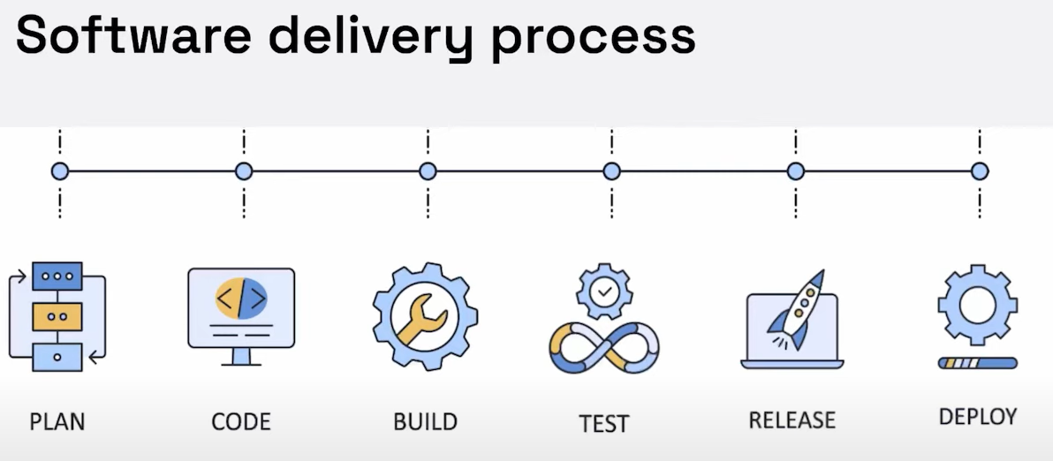
Delivery Process

Slide 5
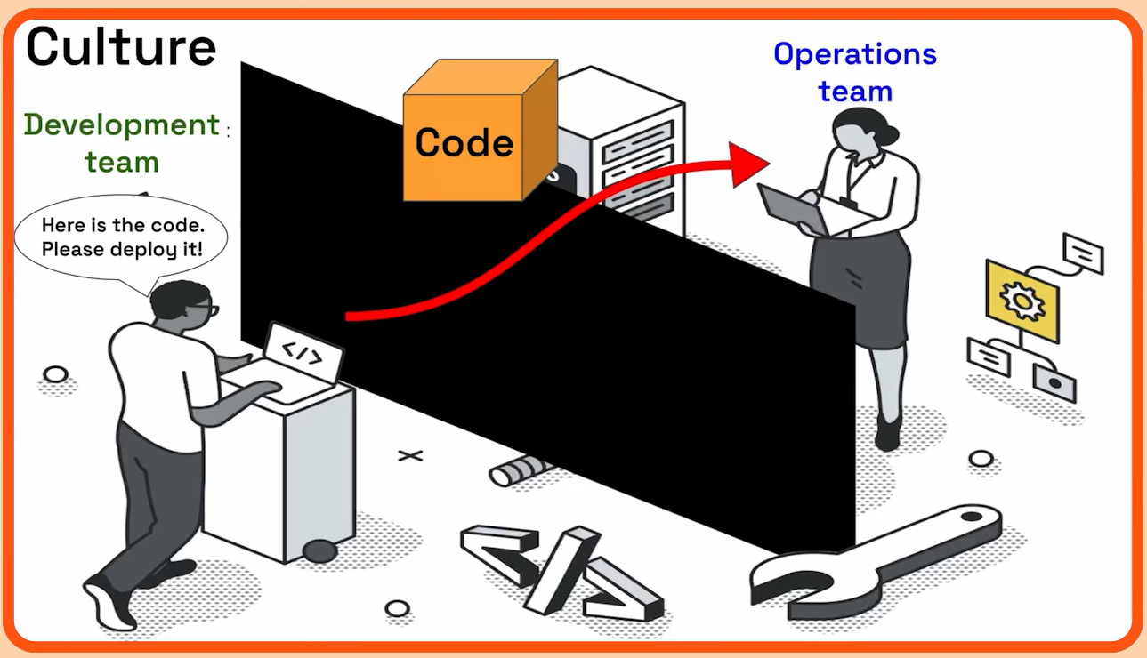
Devops

Slide 6
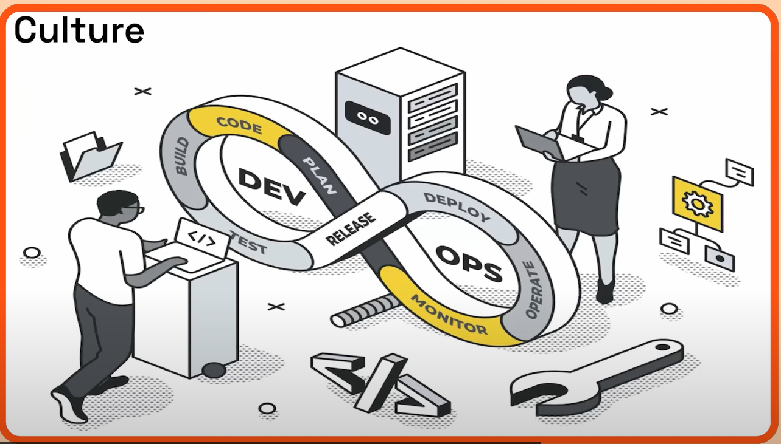
Devops

Slide 7
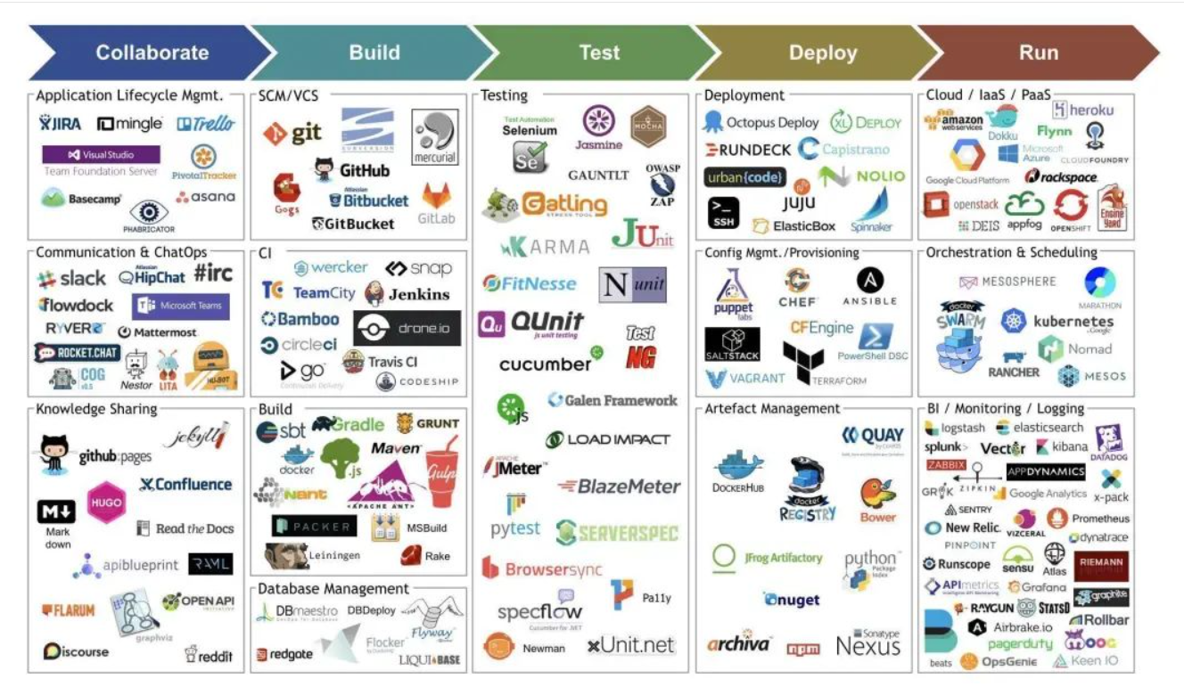
Devops Tools

Slide 8
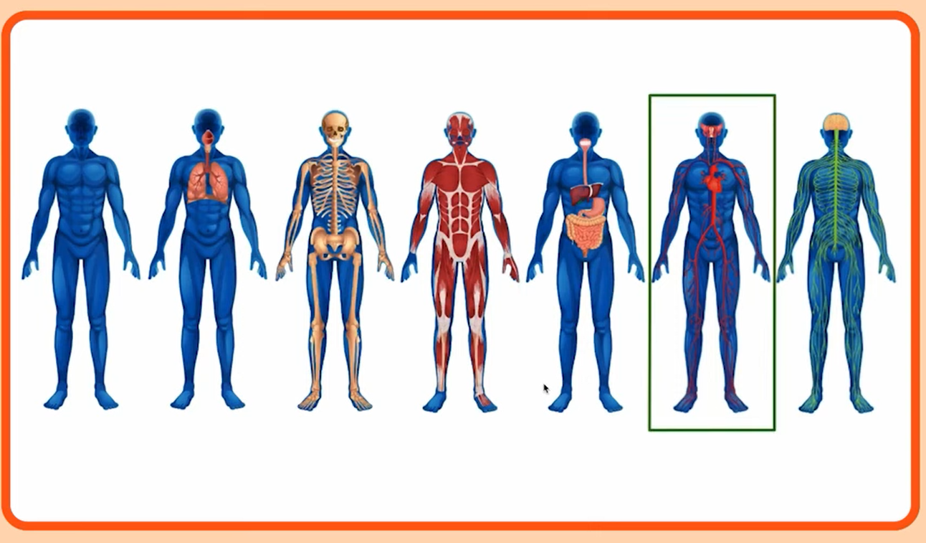
What is continuous monitoring

Slide 9
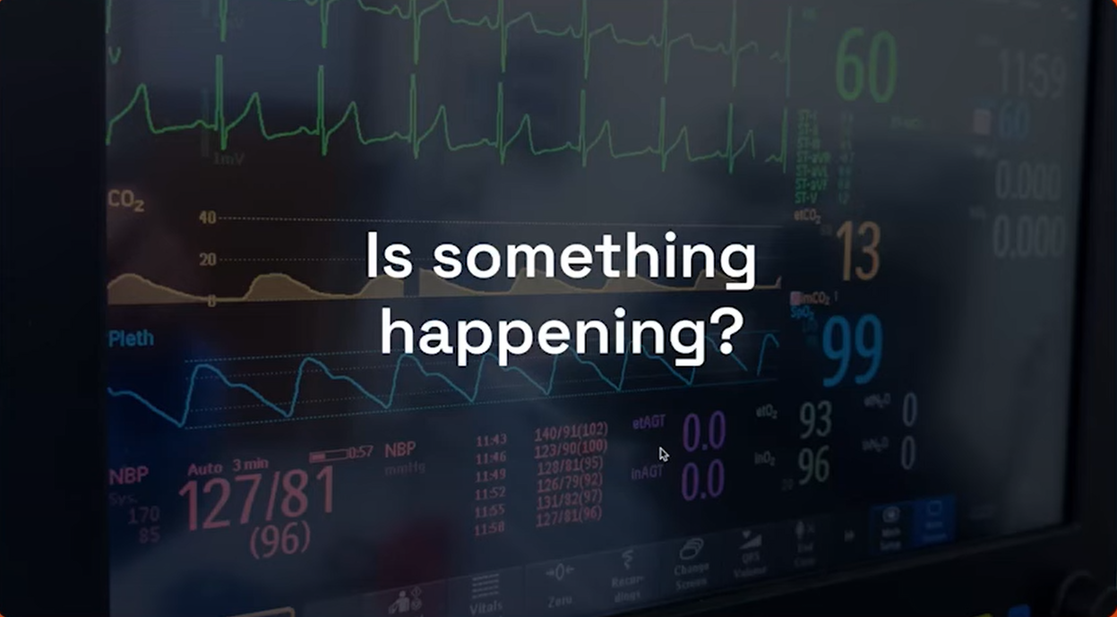
What is continuous monitoring

Slide 10

What is continuous monitoring

Slide 11
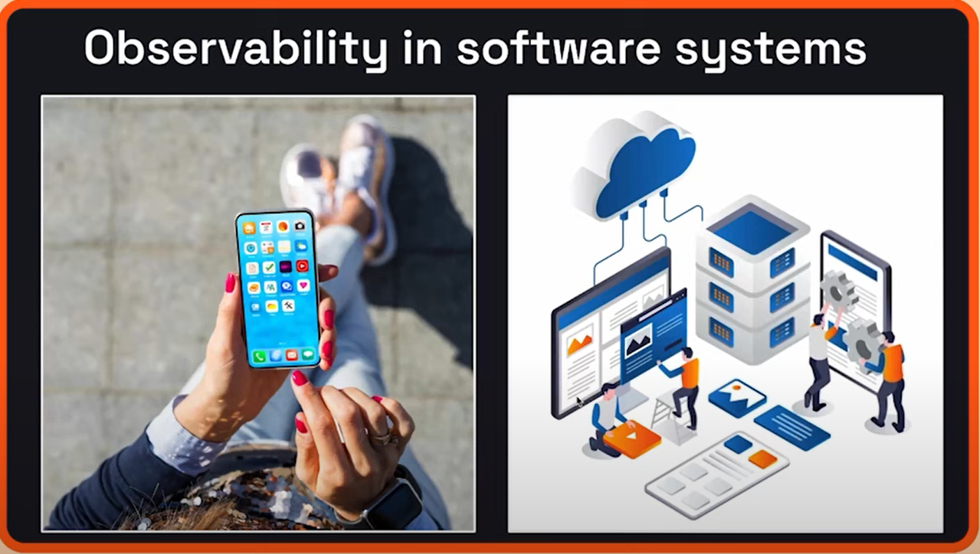
What is continuous monitoring

Slide 12
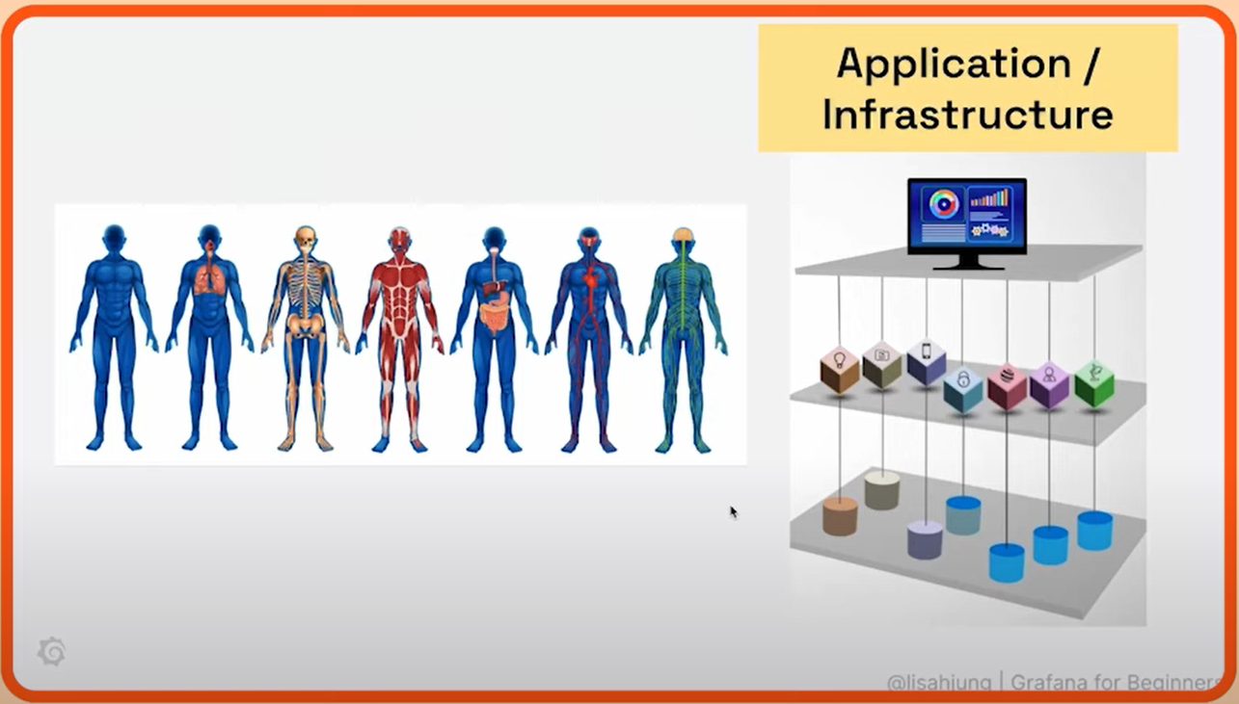
What is continuous monitoring

Slide 13
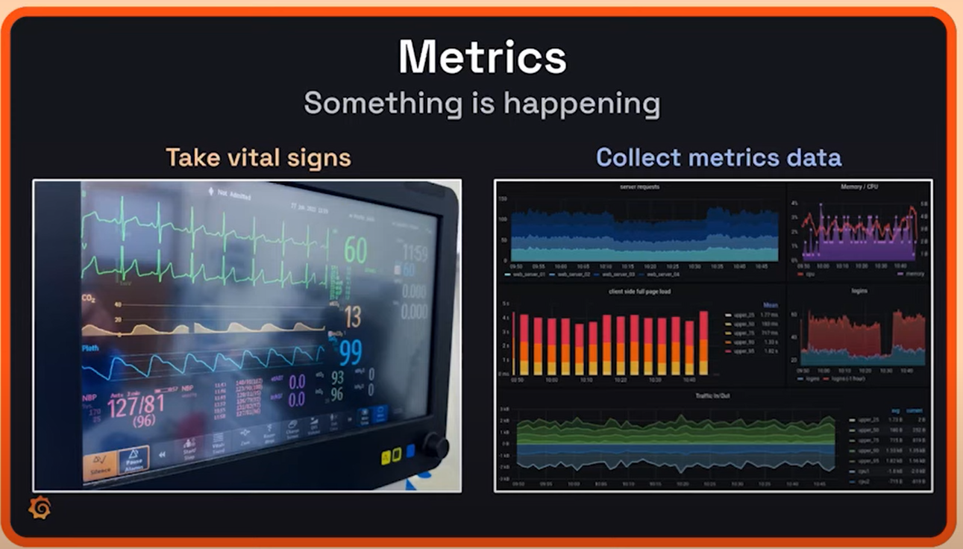
What is continuous monitoring

Slide 14
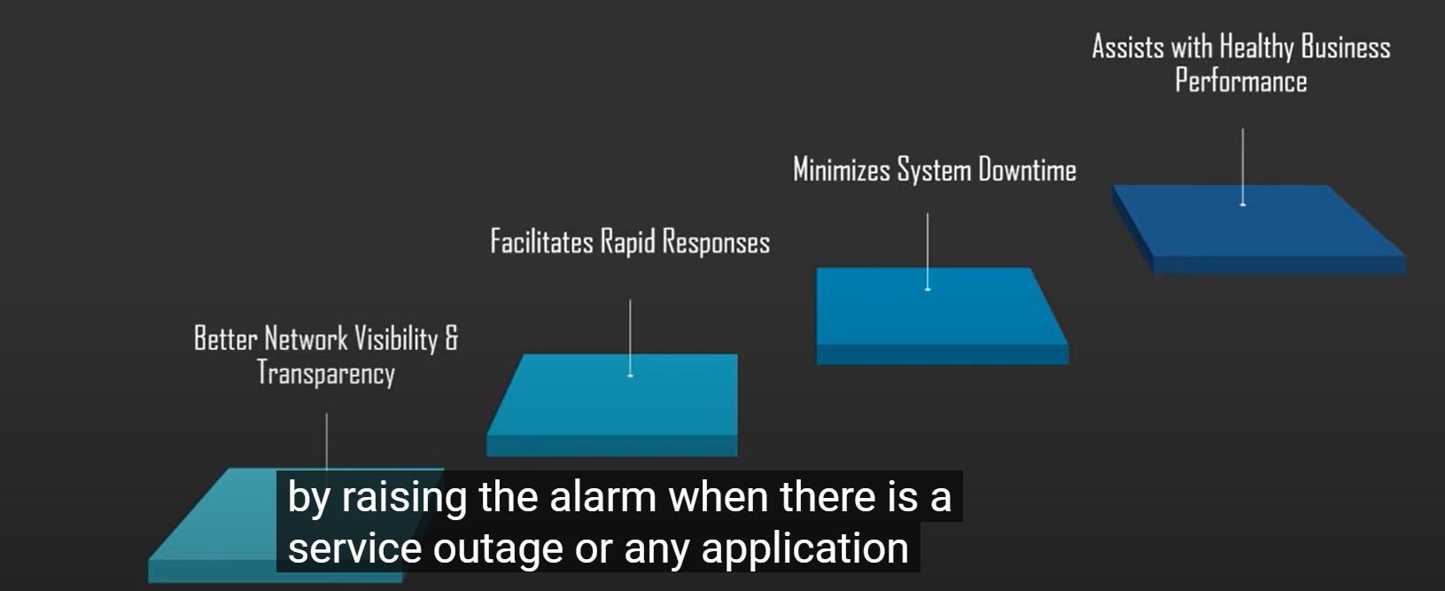
What is continuous monitoring

Slide 15
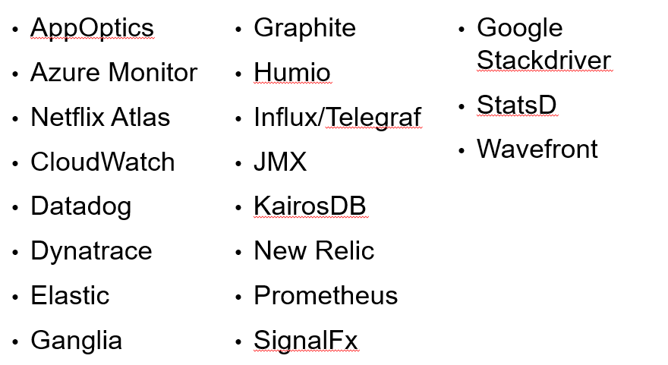
Monitoring Systems

Slide 16
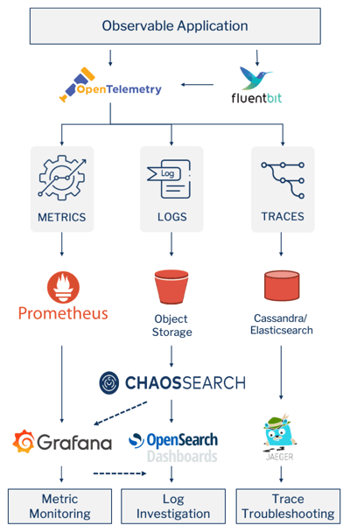
Monitoring Systems

Slide 17
What is Grafana
Grafana, an open-source data analysis solution, serves a vital role in the world of data analytics.
Its main objective is to enable data analysis using metrics.
Users can efficiently visualize their data by creating consolidated charts and graphs in a unified dashboard or multiple dashboards.
It makes us to interpret and understand complex data sets.

Slide 18
What is Grafana
Grafana has a thriving community of enthusiasts who share reusable dashboards.
Grafana supports a huge number of data sources.
The most common use case of Grafana is displaying time series data, such as memory or CPU over time, alongside the current usage data.
For organizations that prioritize data security and are cautious about transmitting data to external cloud providers, Grafana offers an exceptional advantage.
It can be deployed on-premises, ensuring that data remains within the organization’s infrastructure.

Slide 19
What is Grafana
Grafana runs as a process on our computer or server.
We access the interface through our browser.
Our dashboard can display data as single numbers, graphs, charts, or even a heat map.

Slide 20
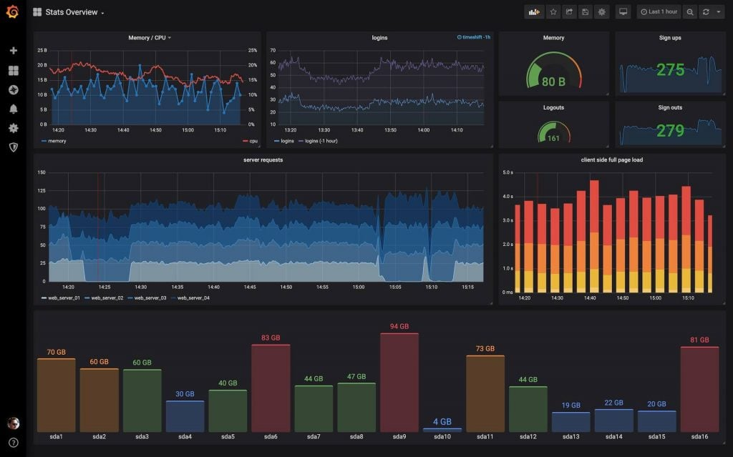
What is Grafana

Slide 21
Why do we need Grafana
Data Source Compatibility
One of the remarkable strengths of Grafana is its ability to seamlessly connect with an array of data sources.
These sources include Graphite, Prometheus, Influx DB, Elastic Search, MySQL, PostgreSQL, and many more.
Grafana allows users to develop custom plugins, affording them the flexibility to connect to data sources of their choosing.

Slide 22
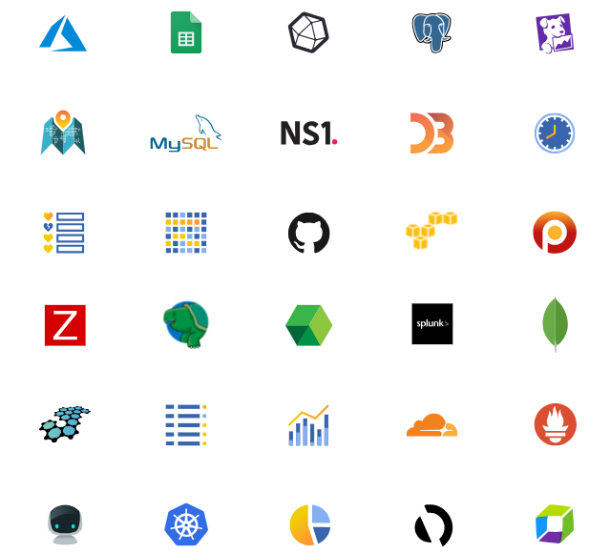
Why do we need Grafana

Slide 23
Why do we need Grafana
Time Series Analysis
Grafana excels in the domain of time series analysis, making it an invaluable tool for
tracking user behaviour,
monitoring application performance,
assessing error frequencies across diverse environments (production, pre-production, etc.),
categorizing error types,
understanding contextual scenarios.
These insights are instrumental in improving operational performance and making informed decisions.

Slide 24
Grafana Features
Dashboard templating
One of Grafana’s most important functions, dashboard templating helps you to build dashboards that can be reused for different purposes and shared among your organization’s teams.
Provisioning.
While it’s easy to construct a single dashboard by clicking, dragging, and dropping, users who need a lot of dashboards will want to use a script to automate the process.
Grafana allows you to script anything and get control of many dashboards.

Slide 25
Grafana Features
Kiosk mode and playlists
If we want to display your Grafana dashboards on a TV monitor we can use the playlist function to choose which dashboards we need to look through and make them cycle through on the screen.
In view-only mode, the kiosk mode hides all the user interface elements you don’t need.
Custom plugins
We can use plugins to extend Grafana and integrate it with other software, visualizations, and more.
Anything that produces a timestamp and a value can be visualized in Grafana with just a few lines of code.

Slide 26
Grafana Features
Alerting and alert hooks.
If an anticipated scenario occurs, alerts are activated like tripwires.
These events can be reported to the monitoring team through Slack or some other communication channel.
Permissions and teams.
When a company has one Grafana and several teams, they often want to keep things apart while still sharing dashboards.
If we’re using Grafana Enterprise, we can build a team of users and then set permissions on folders, dashboards, and down to the data source level.
SQL data sources
Grafana’s native SQL support allows you to turn anything in a SQL database into metric data that you can graph.
SQL data sources are used by power users to do a variety of fascinating things, such as building business dashboards.

Slide 27
Grafana Features
Authentication
Grafana supports a variety of authentication styles, including LDAP and OAuth, and lets you map users to organizations.
We can also map users to teams in Grafana Enterprise:
Grafana helps us to map the teams in our internal systems to Grafana teams if our organization has its own authentication system.
As a result, we’ll be able to automatically grant access to the dashboards to employees that belong to specific teams.

Slide 28
Why is Grafana so Popular?
Grafana has garnered substantial popularity among professionals, including product leaders, security analysts, and developers.
They rely on Grafana to make data-driven decisions, monitor performance, and gain critical insights into their systems.
The main alternatives to Grafana are Kibana, Tableau and Power BI.
All of them are also tools that offer data visualization and analysis capabilities.
It provides users with options to select the solution that best aligns with their specific requirements.

Slide 29
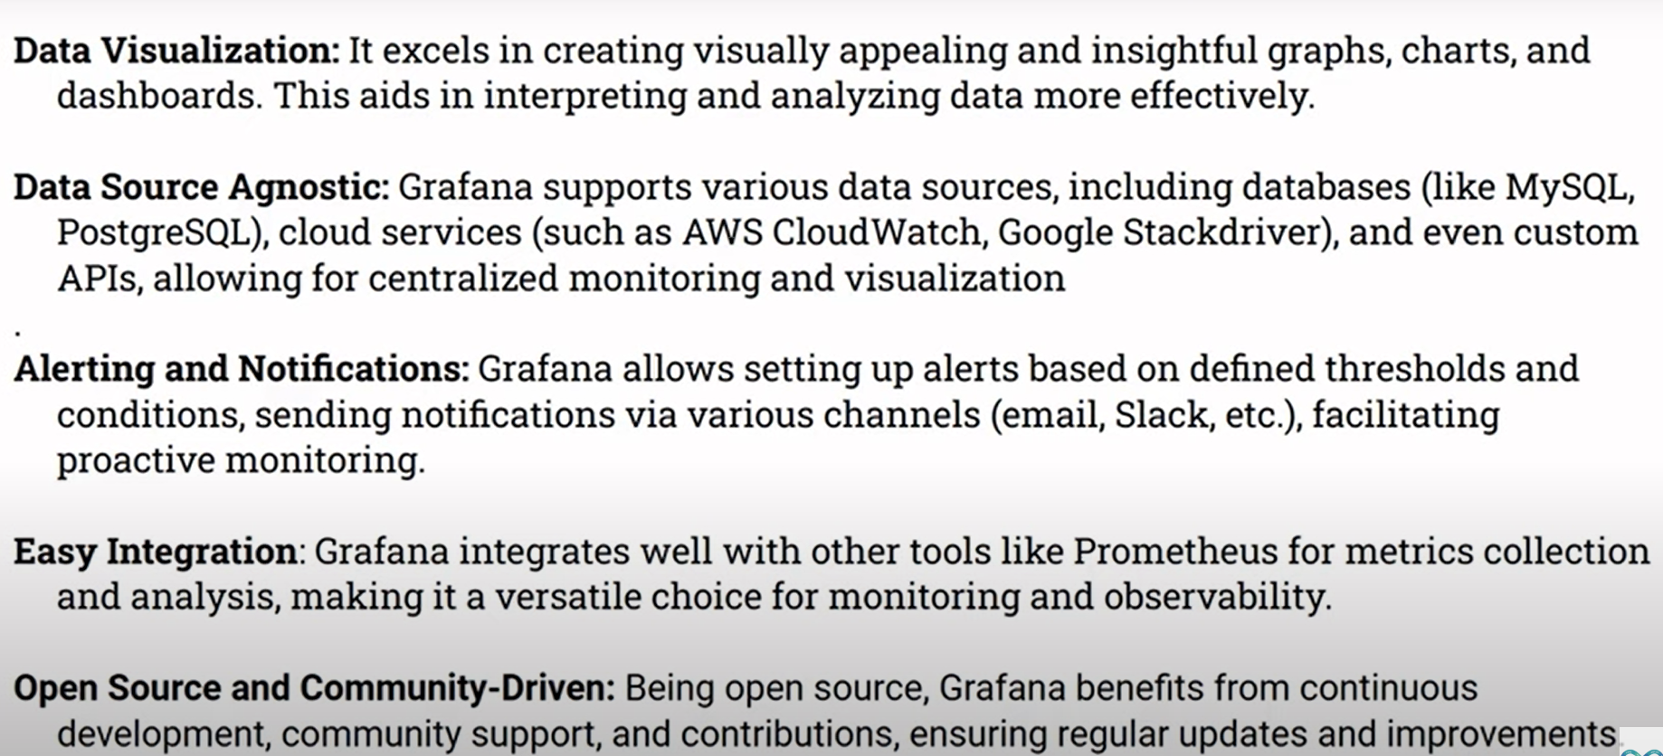
Advantage and Disadvantage of Grafana

Slide 30
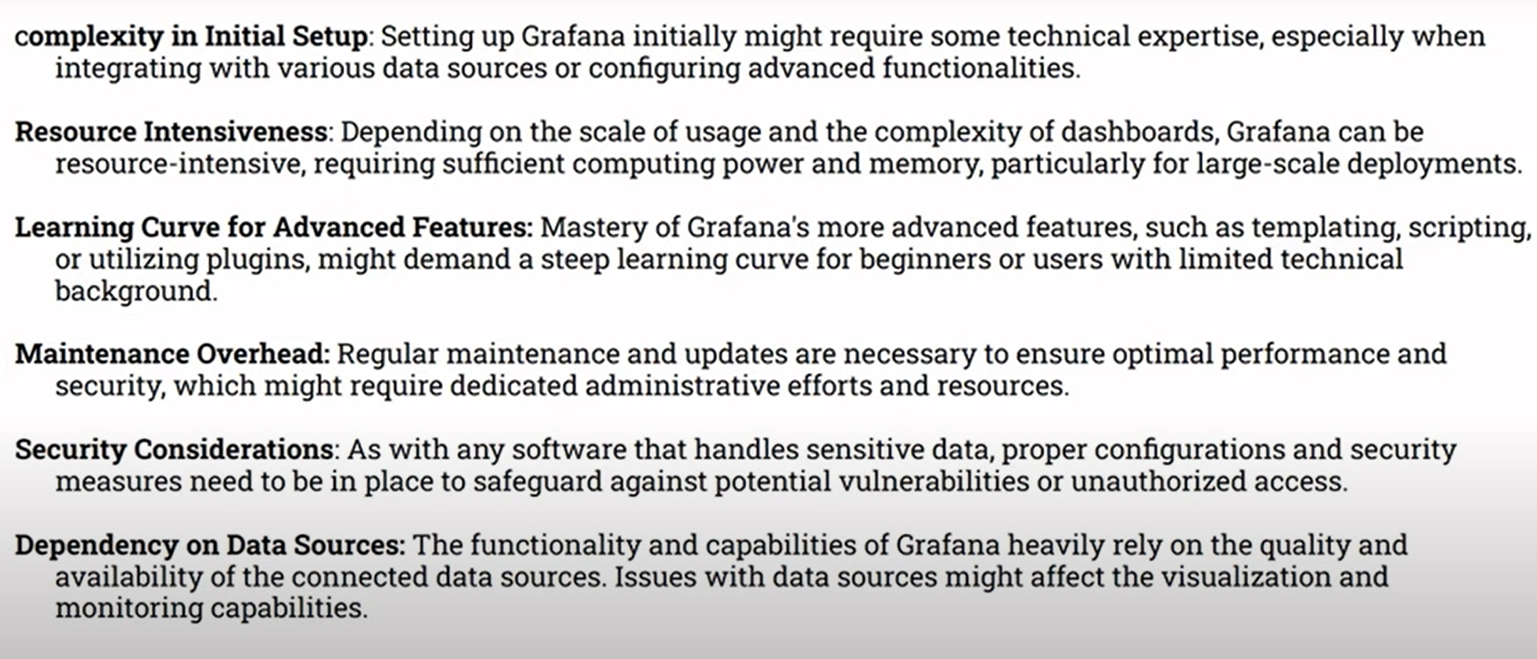
Advantage and Disadvantage of Grafana

Slide 31
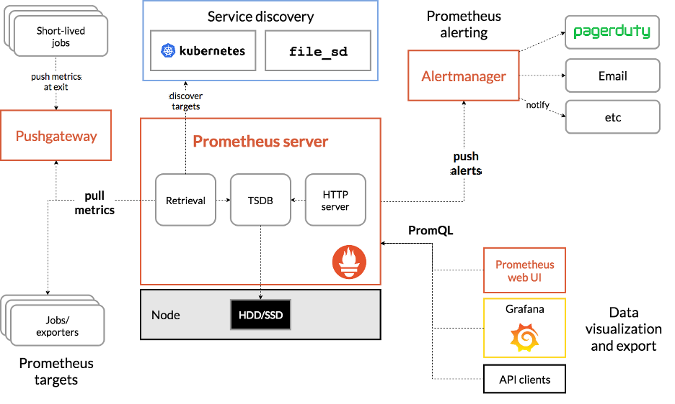
Grafana with other Tools

Slide 32
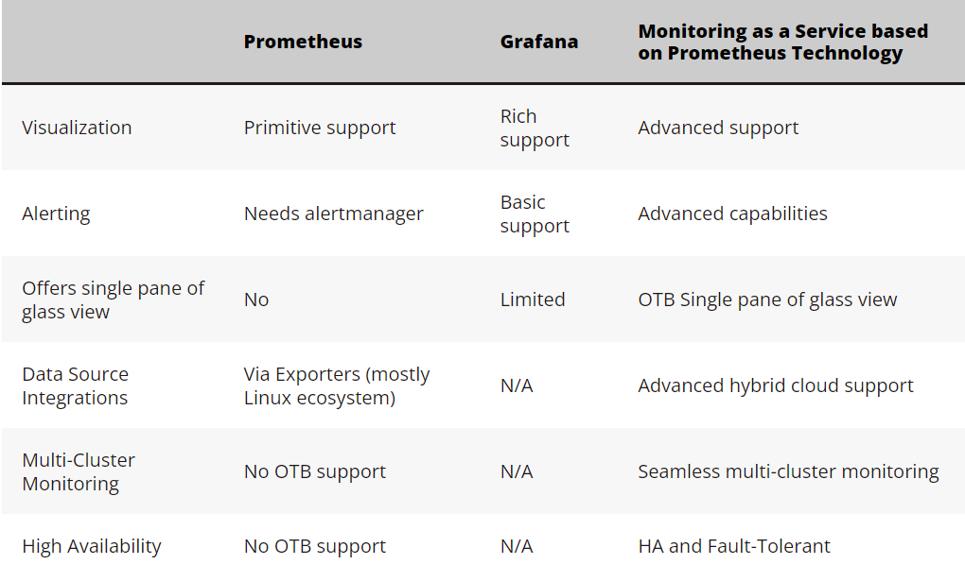
Prometheus vs Grafana

Slide 33
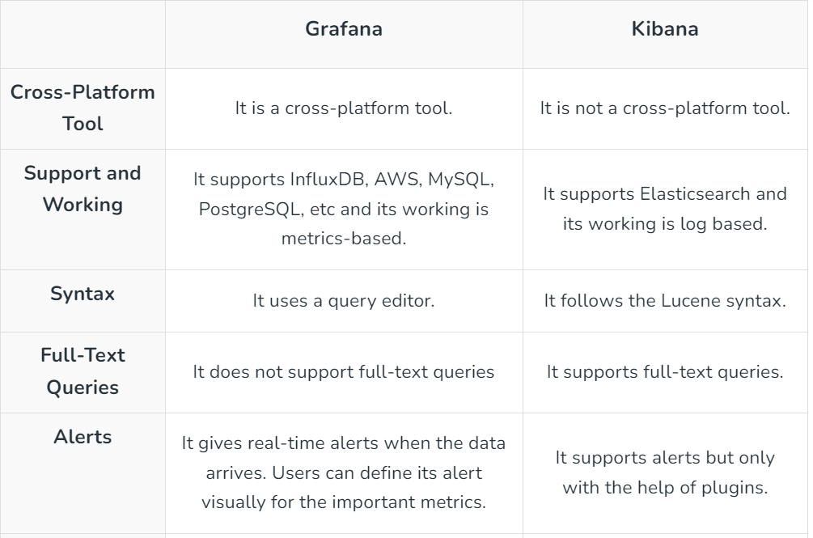
Grafana vs Kibana

Slide 34
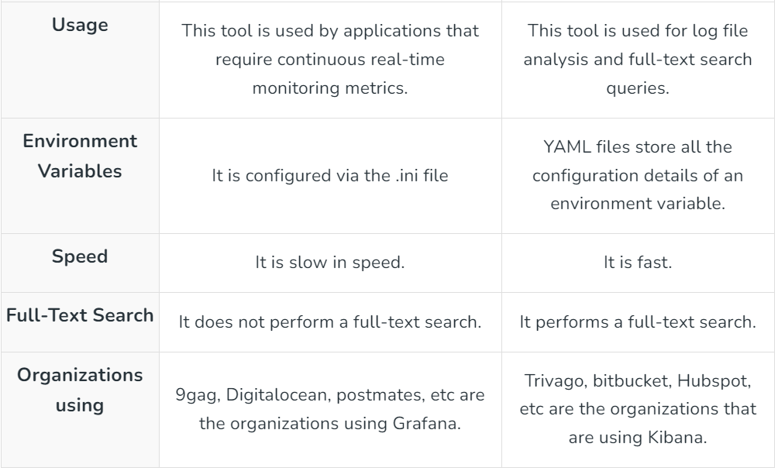
Grafana vs Kibana

Slide 35
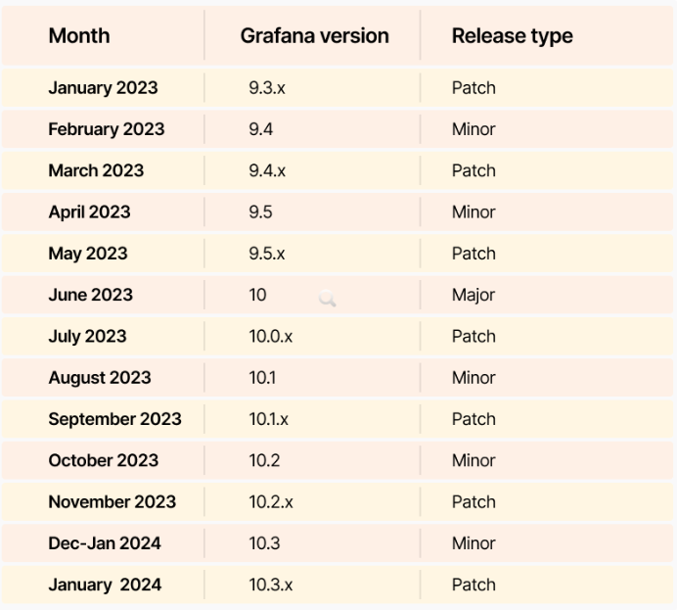
Grafana Releases

Slide 36
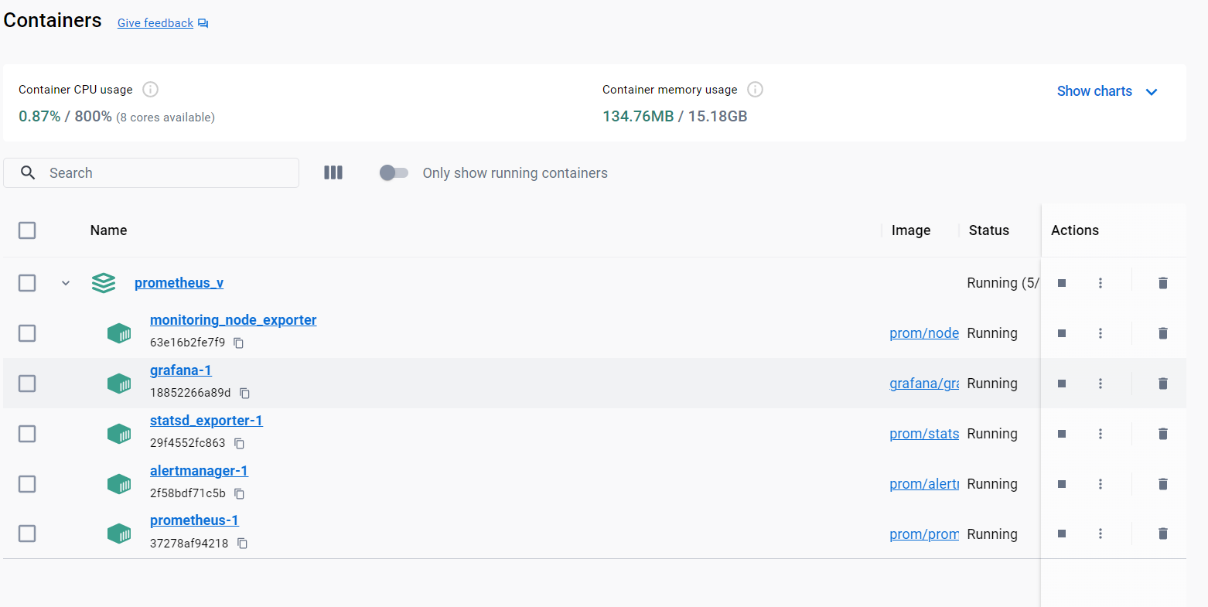
Grafana Installation

Slide 37
Grafana Loki
Loki is an open-source log aggregation tool inspired by Prometheus architecture.
It is designed as horizontally-scalable, highly-available, and multi-tenant to allow you to collect, store, and search log data.
Loki was created by Grafana Labs, with its first version released in 2019.
Loki is designed to keep indexing low.
It does this by making use of labels.
Labels are any key-value pairs that can be used to describe a log stream.

Slide 38
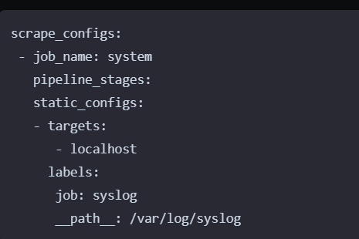
Grafana Loki

Slide 39
Key Features of Grafana Loki
It provides you with LogQL as its own query language, allowing you to powerfully query and filter your logs.
Has support Grafana integration for real-time log visualizations and querying.
It uses labels to identify log streams.
Natively integrates with Prometheus, Grafana and K8s.
PromQL-compatible to allow you access to Prometheus-like labels. This makes Loki easier to use to categorize and label log data while using PromQL to search and analyze logs.
Prometheus Alert manager for sending alerts.
Cost-effective and durable storage as Loki doesn't index logs text contents. It only needs labels for each log stream.
Multi-tenancy support through to allows each tenant's data to be stored independently.

Slide 40
Grafana Loki Installation
wget https://raw.githubusercontent.com/grafana/loki/v3.0.0/production/docker-compose.yaml -O docker-compose.yaml

Slide 41
Get started with Grafana Cloud
To sign up for a Grafana Cloud account, complete the following steps:
Navigate to https://grafana.com/products/cloud/.
Click Start for free on the banner.
Follow the instructions to finish setting up your account and access the Cloud Account Portal.

Slide 42
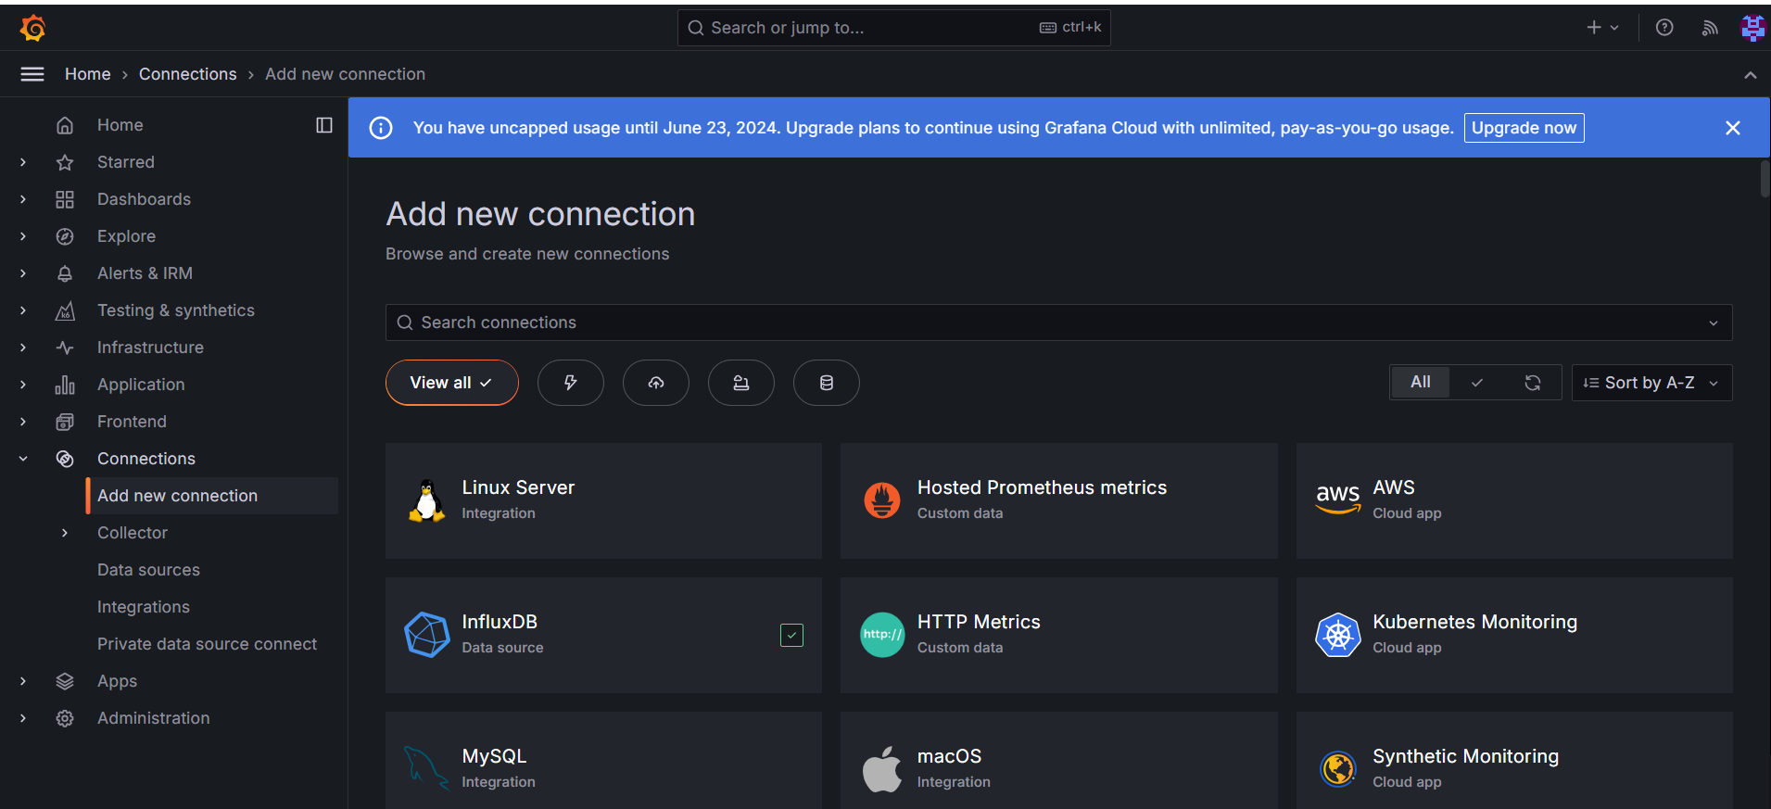
Get started with Grafana Cloud

Slide 43
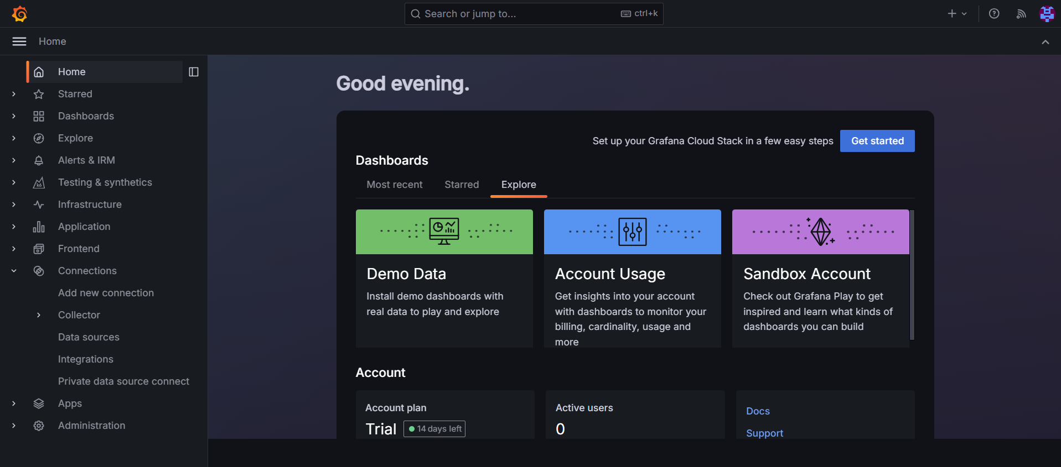
Get started with Grafana Cloud

Slide 44
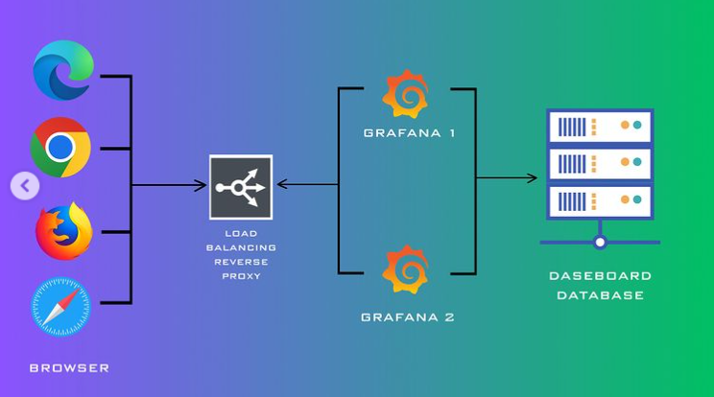
How Grafana Works

Slide 45
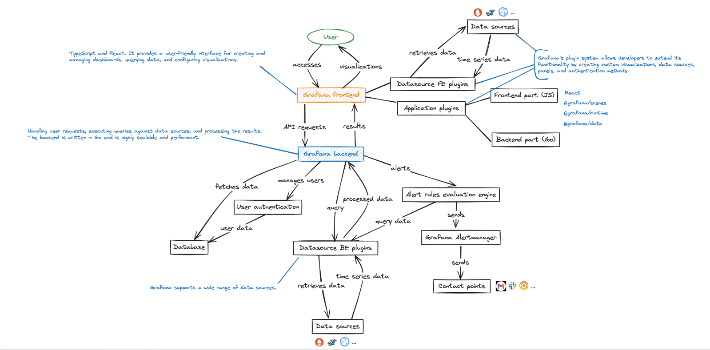
Grafana Architecture

Slide 46
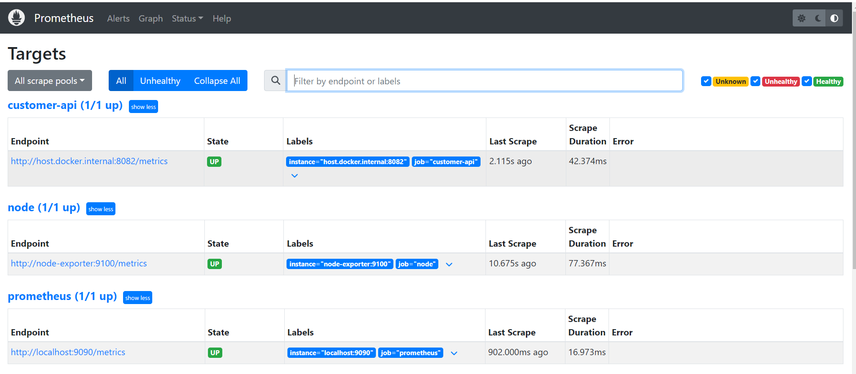
Grafana Prometheus Connection

Slide 47
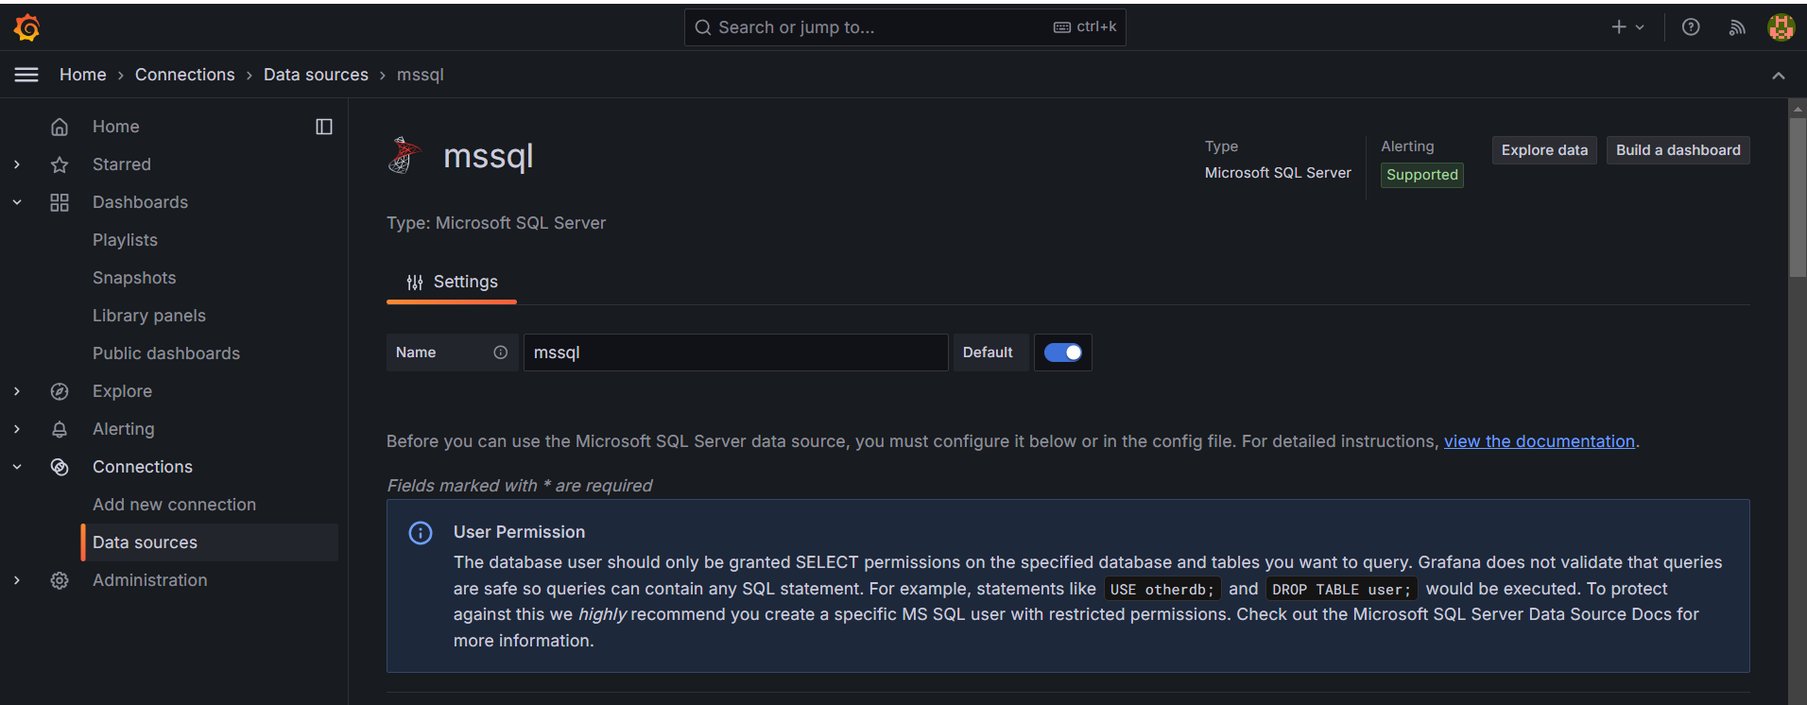
Grafana MSSQL Connection

Slide 48
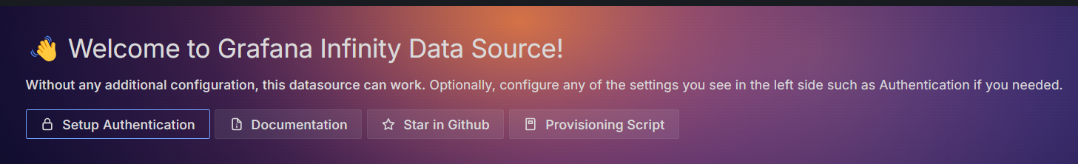
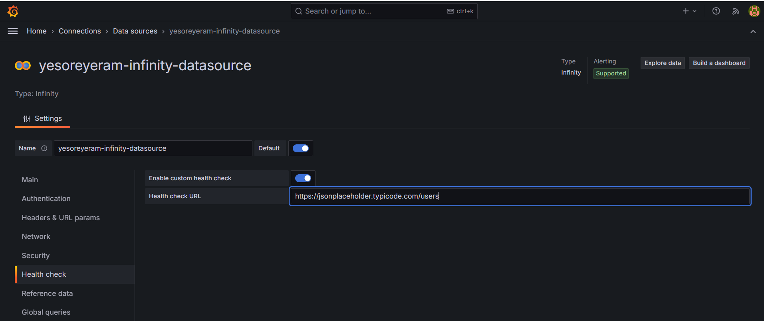
Grafana Infinity DB – AI/LLM Native DB– JSON Data
No need to create container.
Just add infinity db plugin and create data source.

Slide 49
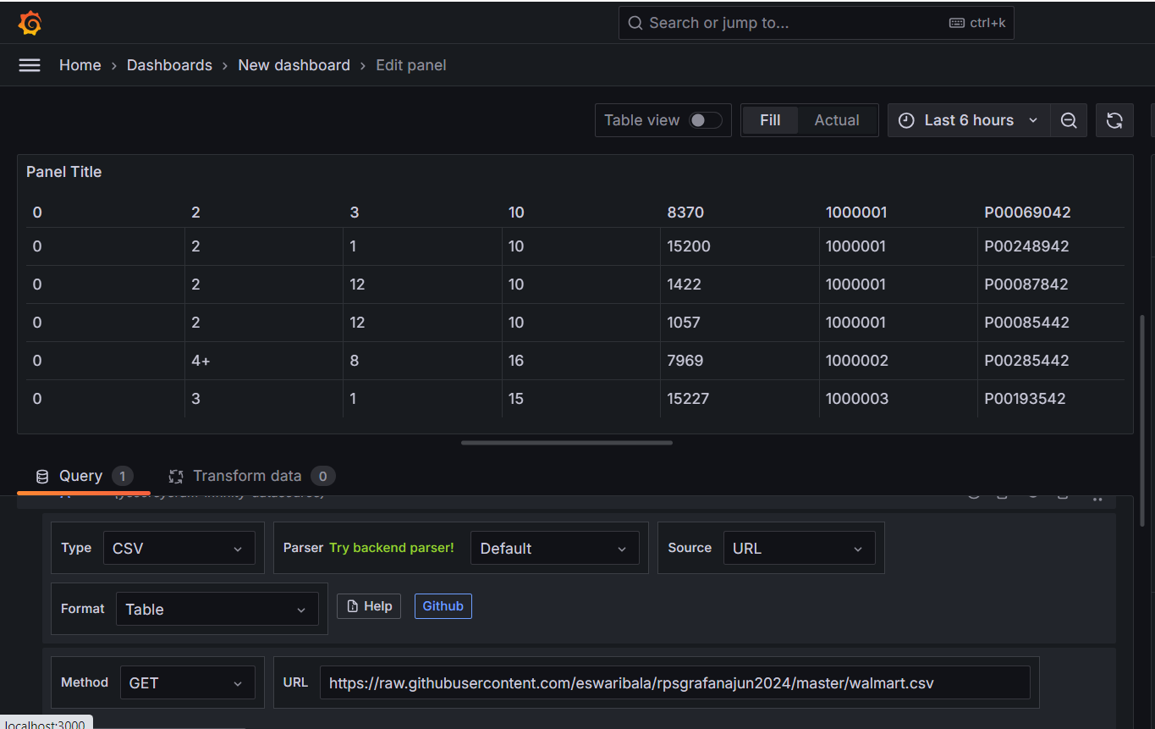
Grafana Infinity DB - CSV

Slide 50
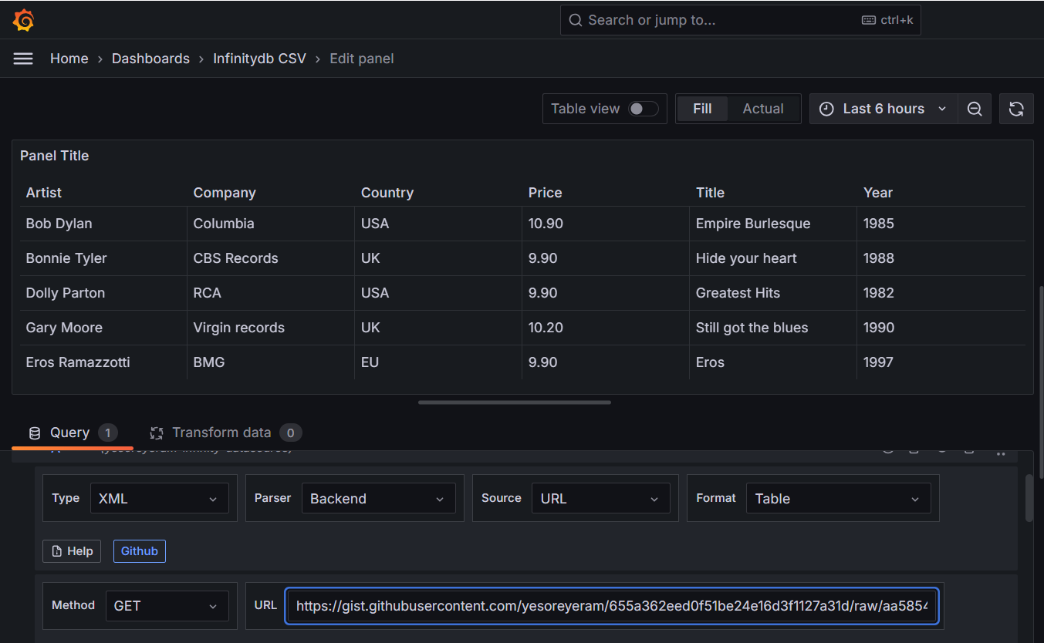
Grafana Infinity DB - XML

Slide 51
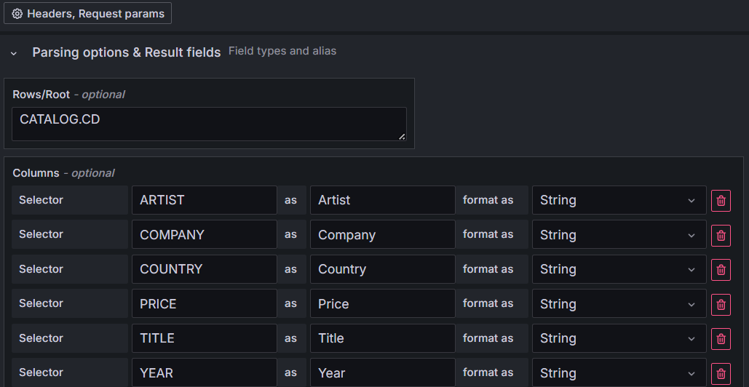
Grafana Infinity DB - XML

Slide 52
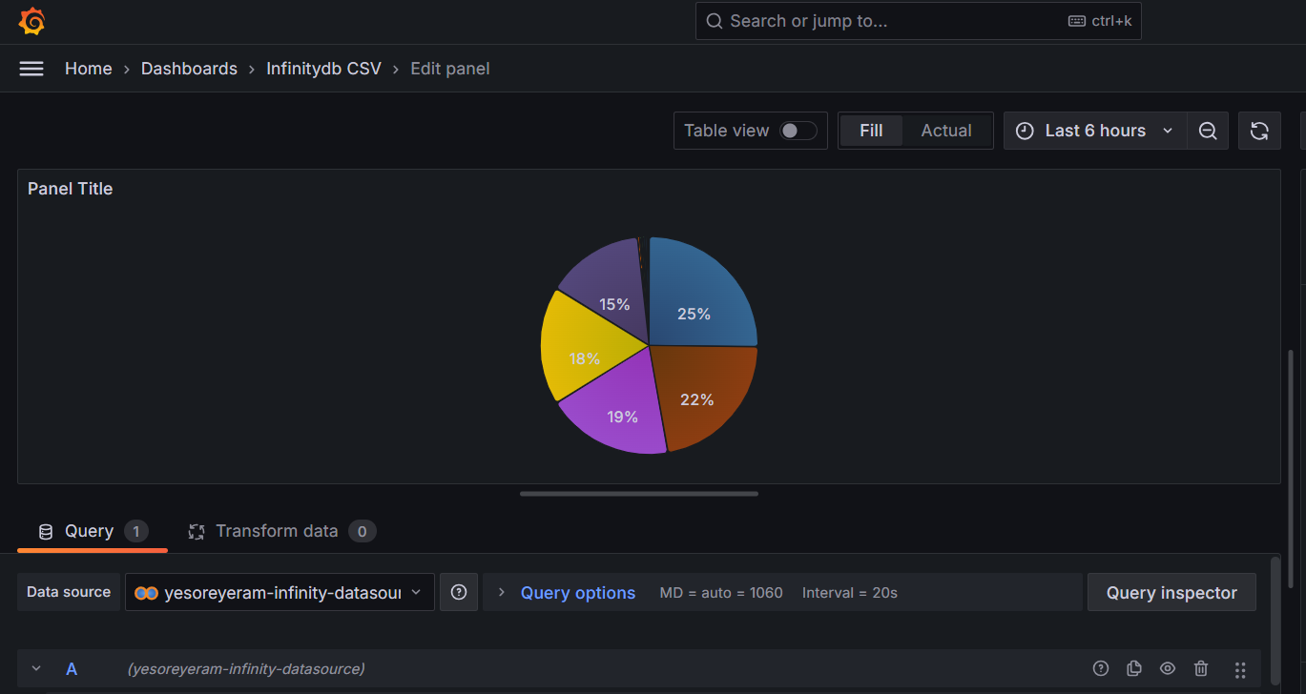
Grafana Infinity DB - XML

Slide 53
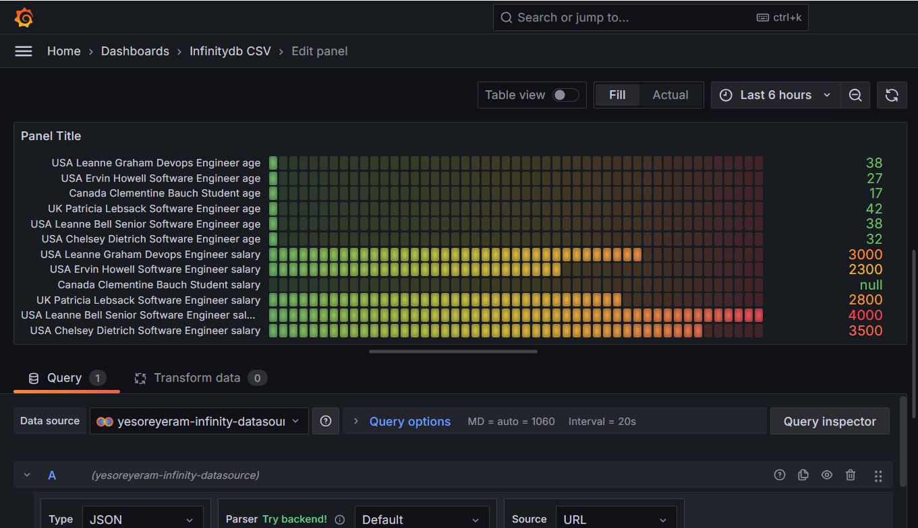
Grafana Infinity DB - XML

Slide 54
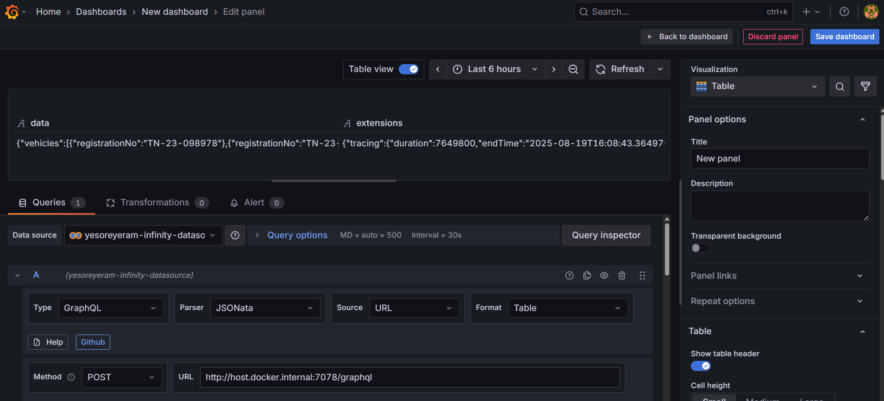
Grafana Infinity DB - Graphql

Slide 55
Amazon CloudWatch
Amazon CloudWatch is a monitoring and observability service for AWS resources, applications, and services running on AWS and on-premises. It helps you collect and track:
Metrics (e.g., CPU utilization, memory, custom app metrics)
Logs (application logs, server logs, Lambda logs)
Events (state changes in AWS resources)
Alarms (trigger notifications or automated actions when thresholds are crossed)

Slide 56
Key Features
Metrics Monitoring
Predefined AWS metrics (EC2 CPU, RDS connections, S3 bucket size, etc.)
Custom application metrics (via API/SDK/CloudWatch Agent)
Logs Collection
Store, search, and analyze logs (EC2, Lambda, ECS, Kubernetes, etc.)
Integrates with CloudWatch Logs Insights for querying logs.
Alarms & Notifications
Trigger Amazon SNS, Auto Scaling, or custom actions when thresholds are breached.
Events
React to AWS resource changes (like EC2 instance state changes) using EventBridge.
Dashboards
Create real-time visualizations of metrics/logs for observability.

Slide 57
Common Use Cases
Monitor EC2 instance health (CPU, Disk, Network).
Collect application logs from ECS/EKS or Lambda.
Trigger alarms for high memory/CPU usage.
Automate scaling (Auto Scaling groups with CloudWatch alarms).
Security monitoring (track unauthorized access patterns).

Slide 58
Getting Started
Enable CloudWatch (by default active in AWS accounts).
Install CloudWatch Agent on EC2/servers for detailed system-level metrics.
Push logs/metrics from applications (via AWS SDK/CloudWatch API).
Set alarms (e.g., alert if CPU > 80%).
Create dashboards to visualize key metrics.

Slide 59
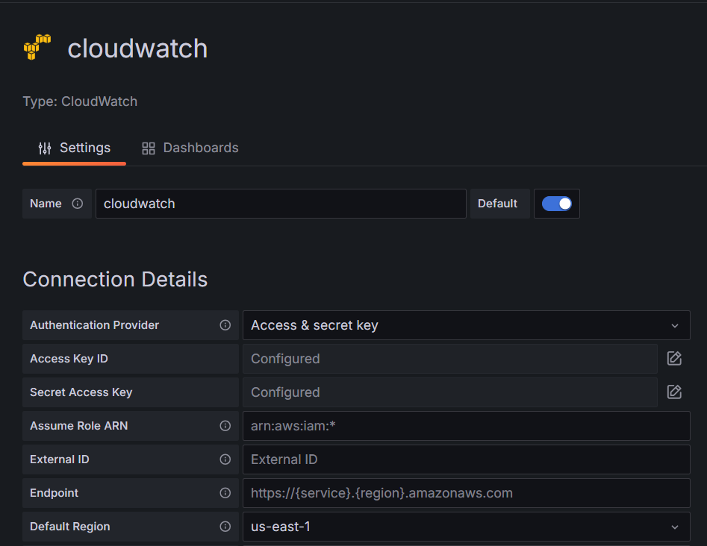
Amazon Cloud Watch as Data Source

Slide 60
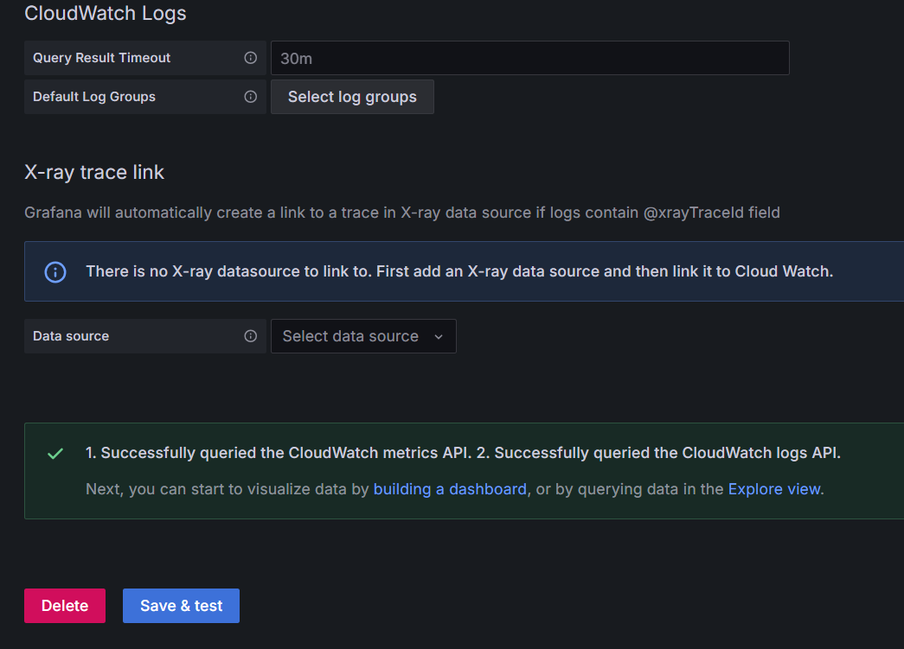
Amazon Cloud Watch as Data Source

Slide 61
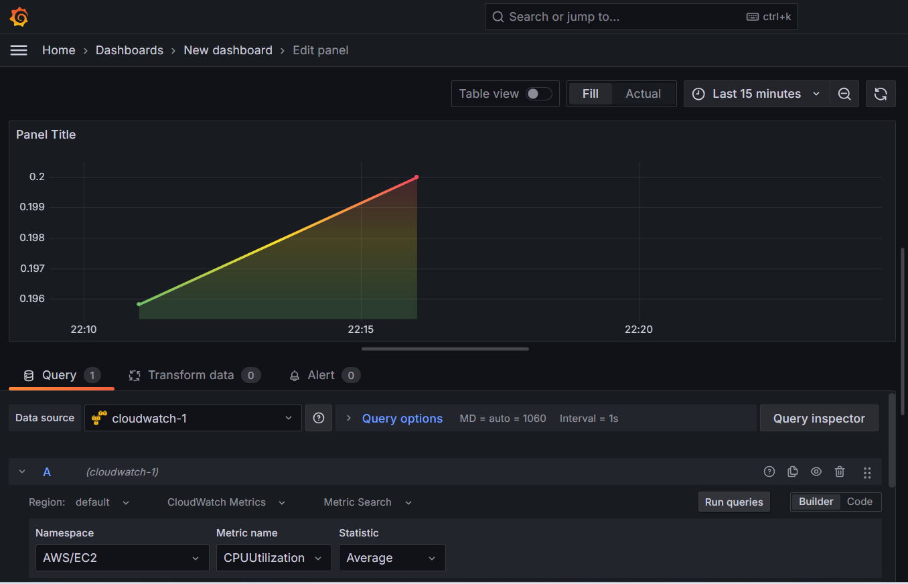
Amazon Cloud Watch as Data Source

Slide 62
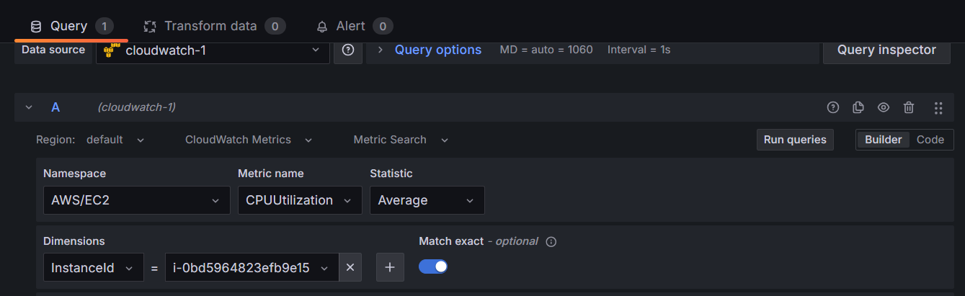
Amazon Cloud Watch as Data Source

Slide 63
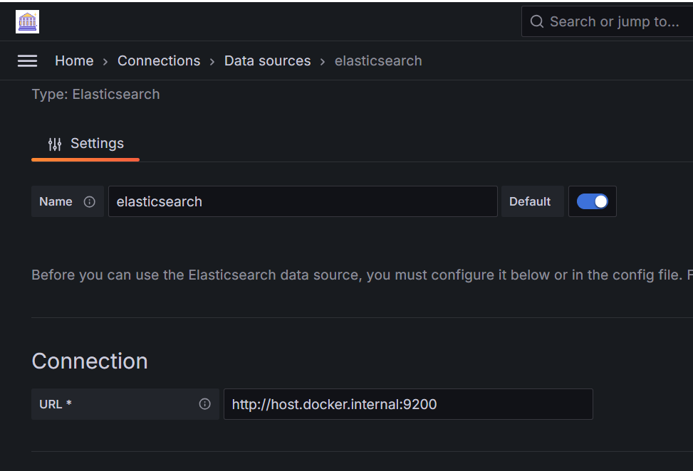
Grafana Elastic Search

Slide 64
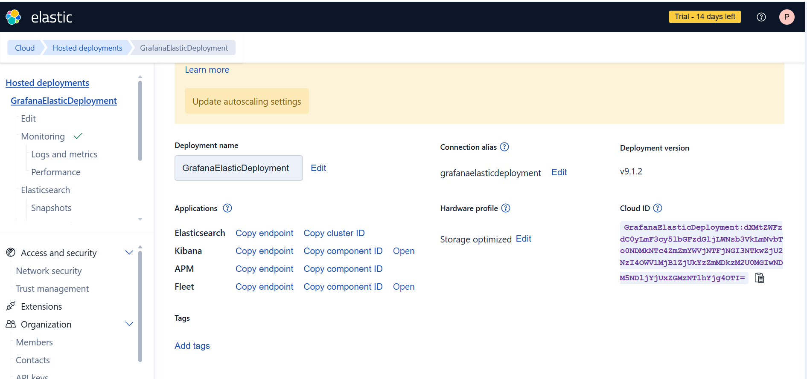
Grafana Elastic Search Cloud
Download password while creating

Slide 65
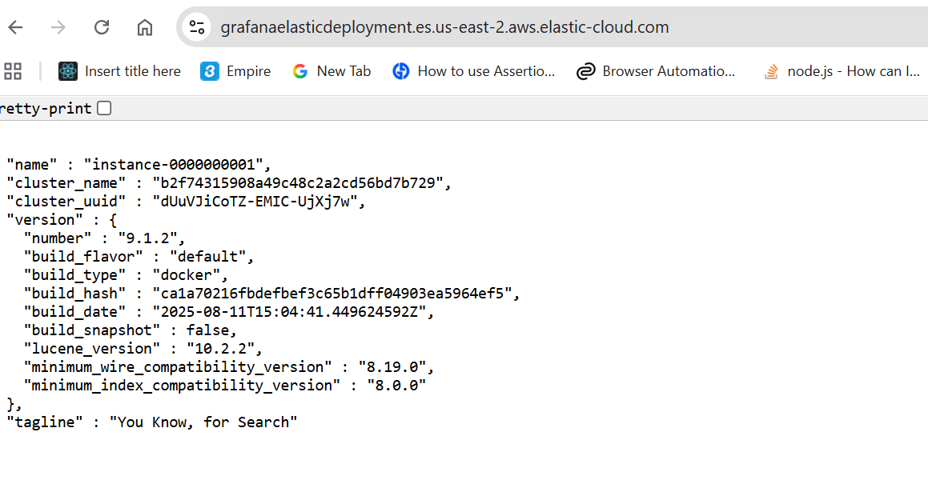
Grafana Elastic Search Cloud - Test
Download password while creating

Slide 66
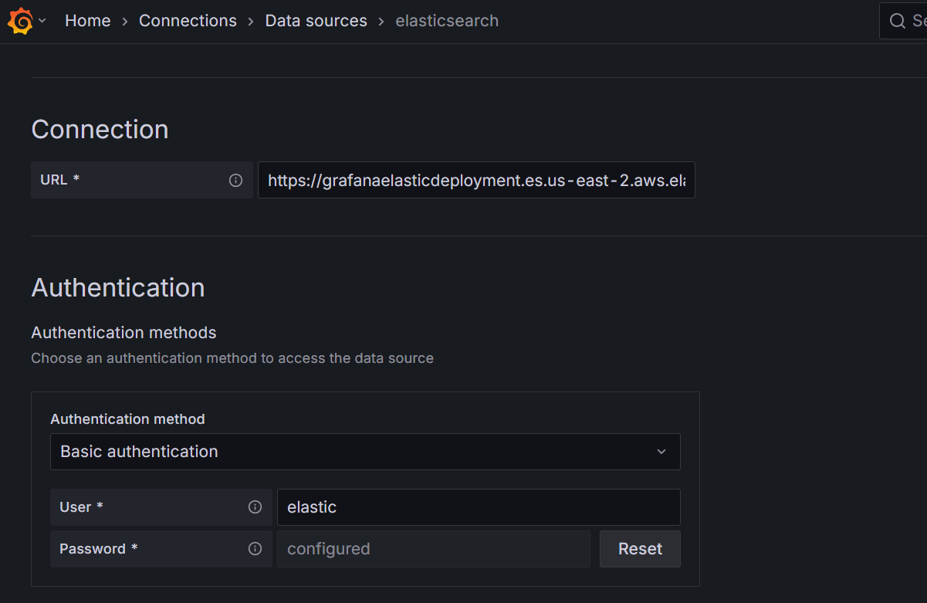
Grafana Elastic Search Cloud

Slide 67
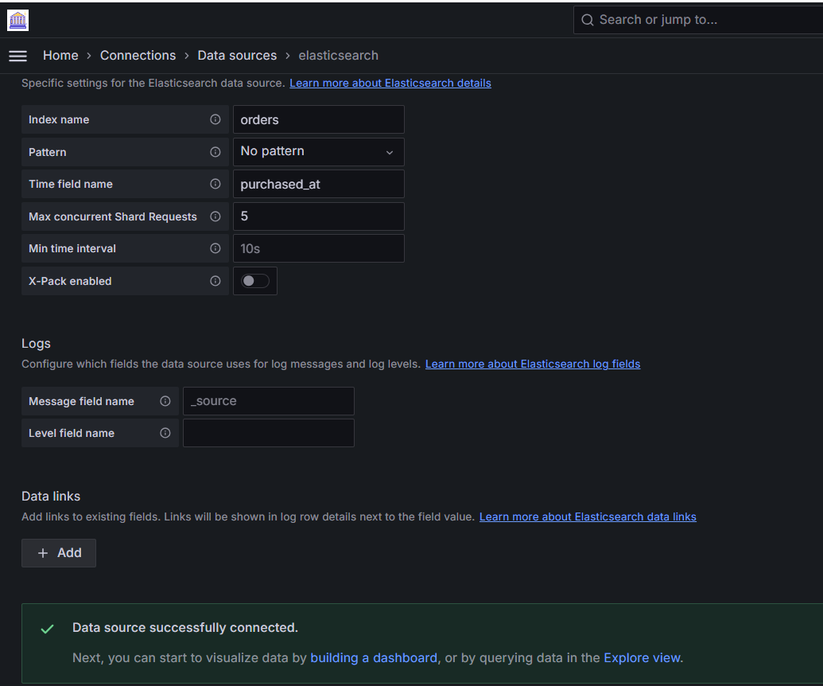
Grafana Elastic Search

Slide 68
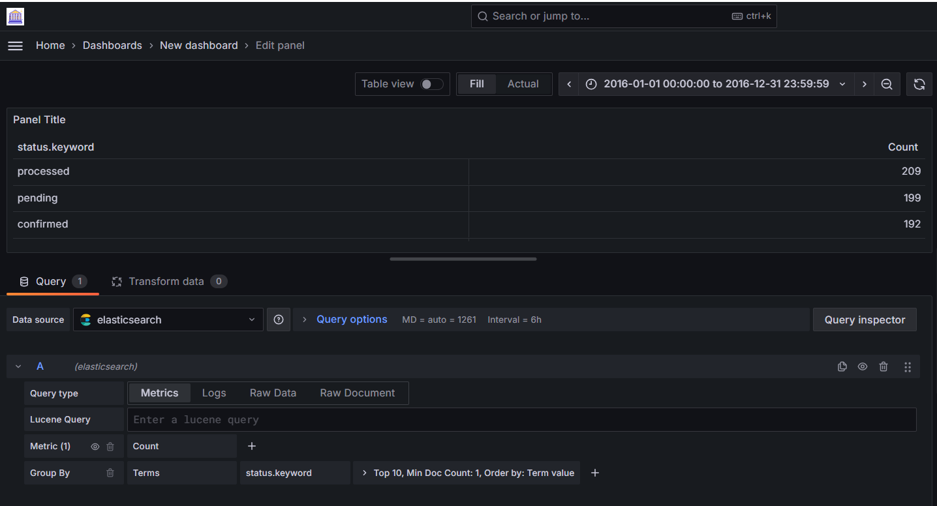


Grafana Elastic Search with Top10
Graphite has the limit function.
InfluxDB has the limit and slimit functions
ElasticSearch has the Size option:

Slide 69
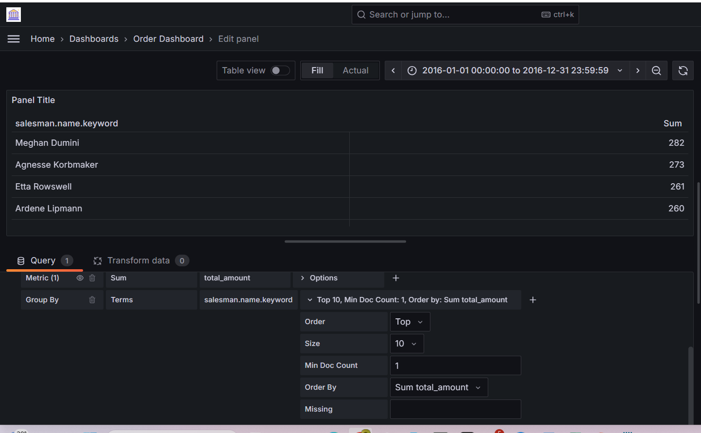
Grafana Elastic Search with Top10

Slide 70
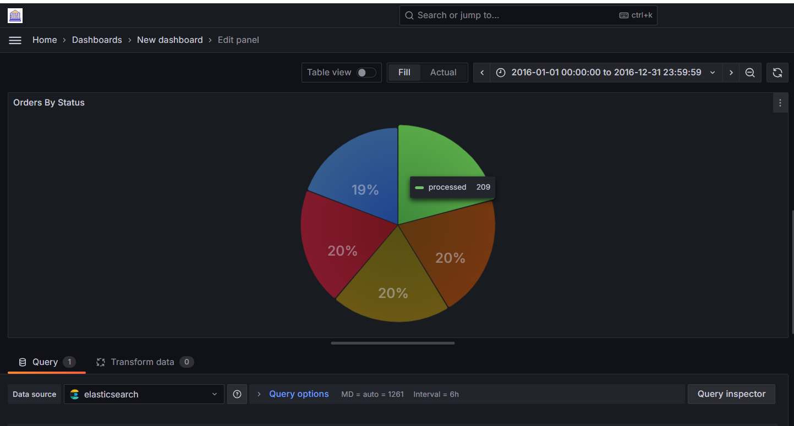
Grafana Elastic Search

Slide 71
Graphite
What is Graphite?
Graphite is a time-series monitoring tool that lets you:
Collect metrics (from apps, servers, containers…).
Store them in a time-series DB (Whisper).
Visualize them in dashboards and graphs (Graphite-Web, or Grafana).
It’s one of the older but still widely used observability stacks.

Slide 72
Graphite
What is Graphite?
Graphite is an open-source monitoring tool designed for collecting, storing, and graphing real-time numeric time-series data. Its core components are:
Carbon: a daemon that receives time-series data via protocols like StatsD or Graphite plaintext.
Whisper: a lightweight, round-robin database optimized for storing time-series data.
Graphite webapp: a Django-based front-end (using Cairo for rendering) that generates graphs on demand.

Slide 73
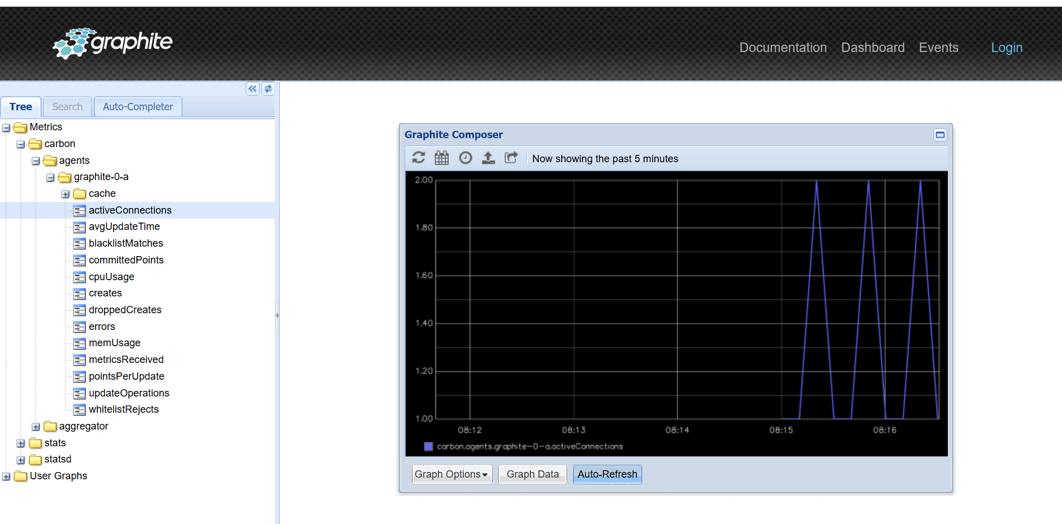
Graphite

Slide 74
Dashboard Playlists
A playlist is a list of dashboards that are displayed in a sequence.
We might use a playlist to build situational awareness or to present your metrics to our team or visitors.
Grafana automatically scales dashboards to any resolution, which makes them perfect for big screens.
We can access the Playlist feature from Grafana’s side menu, in the Dashboards submenu.

Slide 75

Dashboard Playlists

Slide 76

Dashboard Playlists

Slide 77

Dashboard Playlists

Slide 78
Create and manage reports
Reporting enables you to automatically generate PDFs from any of your dashboards and have Grafana email them to interested parties on a schedule.
This is available in Grafana Cloud and in Grafana Enterprise.

Slide 79


Create and manage reports

Slide 80

Create and manage reports

Slide 81

Create and manage reports

Slide 82

Create and manage reports

Slide 83
Grafana Alerting
Grafana Alerting typically allows us to learn or understand the problems in our system, just a few moments after they occur.
Enabling us to create, manage, and act on our alerts in a single, consolidated view, and overall improve our team’s ability to identify and resolve issues as fast as possible.
It is available for Grafana OSS, Grafana Enterprise, or Grafana Cloud.

Slide 84

How do Grafana alert works

Slide 85

How do Grafana alert works

Slide 86


How do Grafana alert works (Only Time Series)

Slide 87

How do Grafana alert works

Slide 88

How do Grafana alert works

Slide 89
Grafana OAuth
There are numerous authentication methods available in Grafana to verify user identity.
The authentication configuration dictates which users can access Grafana and the methods they can use for logging in.
We can also configure Grafana to automatically update users’ roles and team memberships in Grafana based on the information returned by the auth provider integration.
When deciding on an authentication method, it’s important to take account your current identity and access management system.
We should also consider the specific authentication and authorization features you require.

Slide 90
Grafana OAuth
Grafana provides OAuth2 integrations for the following auth providers:
Azure AD OAuth
GitHub OAuth
GitLab OAuth
Google OAuth
Grafana Com OAuth
Keycloak OAuth
Okta OAuth

Slide 91

Grafana GITHUB OAuth2 Authentication

Slide 92

Grafana GITHUB OAuth2 Authentication

Slide 93


Grafana GITHUB OAuth2 Authentication

Slide 94

Azure Active Directory- Microsoft Entra ID

Slide 95


Azure Active Directory- Microsoft Entra ID

Slide 96

Azure Active Directory- Microsoft Entra ID

Slide 97

Azure Active Directory- Microsoft Entra ID

Slide 98

Azure Active Directory- Microsoft Entra ID

Slide 99

Azure Active Directory- Microsoft Entra ID

Slide 100

GITLAB Setup

Slide 101

GITLAB Setup

Slide 102



Dashboard Link

Slide 103

Dashboard Link

Slide 104

Panel Link for Various Time Range

Slide 105

Panel Link for Various Time Range

Slide 106

Panel Link for Various Time Range

Slide 107

Image Renderer

Slide 108

Image Renderer using docker-compose

Slide 109

Image Renderer-Grafana.ini

Slide 110

Grafana Elastic Query Variable

Slide 111

Grafana Elastic Query Variable

Slide 112

Grafana Elastic Query Variable

Slide 113

Grafana Prometheus Query Variable

Slide 114


Grafana Prometheus Query Variable

Slide 115

Grafana Prometheus Query Variable

Slide 116


Grafana Cloud Watch Query Variable

Slide 117

Grafana Cloud Watch Query Variable

Slide 118

Grafana Cloud Watch Query Variable

Slide 119

Grafana Cloud Watch Query Variable

Slide 120

Grafana Cloud Watch Query Variable

Slide 121

Grafana Cloud Watch Query Variable

Slide 122

Grafana Cloud Watch Query Variable

Slide 123

Grafana Cloud Watch Query Variable

Slide 124

Grafana MSSQL Query Variable

Slide 125

Grafana MSSQL Query Variable

Slide 126

Grafana MSSQL Query Variable

Slide 127

Grafana Postgres Connection – Password Postgres

Slide 128

Grafana Postgres Query Variable

Slide 129

Grafana MSSQL Query Variable

Slide 130

Grafana Infinitydb Query Variable

Slide 131

Grafana Infinity db Query Variable

Slide 132

Configure Vault with Grafana

Slide 133
Loki
🔹 What is Grafana Loki?
Loki is a horizontally scalable, highly available log aggregation system.
Inspired by Prometheus but for logs instead of metrics.
It doesn’t index the full log text like Elasticsearch — only labels (metadata) are indexed.
This makes it cheaper and faster to run compared to Elastic stack.

Slide 134
Loki
🔹 Loki Components
Loki (server) Stores and queries logs.
Promtail Agent that collects logs from files (e.g., /var/log/*) and pushes them to Loki.
Grafana Used to visualize and query logs with LogQL (Loki Query Language).

Slide 135
Loki
Promtail is an agent that collects logs from various sources and sends them to Loki for storage and querying.
It’s part of the Grafana Loki logging stack, designed to simplify log collection and forwarding.

Slide 136
Loki
The Loki Stack Helm chart is a pre-configured set of resources that deploys the full Loki logging stack in Kubernetes.
This Helm chart simplifies the deployment and management of Loki, Promtail, and other optional components like Grafana, making it easier to set up a complete logging solution within a Kubernetes cluster

Slide 137

Loki

Slide 138

Loki

Slide 139

Loki

Slide 140

Loki

Slide 141
Loki
Refer Loki.txt E:\accgrafana2025\lokiconfig

Slide 142

Loki DS Auto Generated

Slide 143

Loki DS Auto Generated

Slide 144

Grafana Customization Cheatsheet

Slide 145

Grafana Customization Cheatsheet

Slide 146
Grafana Customization Cheatsheet

Slide 147

Grafana Customization Cheatsheet

Slide 148

Monitoring with Docker Compose using InfluxDB, Telegraf and Grafana

Slide 149

Influx DB Setup

Slide 150

Influx DB Setup

Slide 151

Monitoring with Docker Compose using InfluxDB, Telegraf and Grafana

Slide 152


Monitoring with Docker Compose using InfluxDB, Telegraf and Grafana

Slide 153
AWS Grafana Cloud vs Grafana Enterprise
Feature | AWS Grafana Cloud | Grafana Enterprise
Hosting | Managed by AWS | Self-hosted (on-prem or cloud)
Integration | Deep AWS integration | Broad 3rd-party + Enterprise plugins
Pricing | Pay-as-you-go via AWS | Enterprise license (annual)
Management | AWS handles upgrades & scaling | You handle infra & upgrades
Security | AWS IAM, SSO | LDAP, SAML, fine-grained RBAC, audit logs
Plugins | Limited Enterprise plugins included | Full Enterprise plugin catalog
Support | AWS Support + Grafana Labs (via AWS) | Direct Grafana Labs enterprise support
Use case | Cloud-native AWS workloads | Hybrid / On-prem / Strict compliance

Slide 154
AWS Grafana Cloud
Step 1. Open the Service
Go to AWS Console → Amazon Managed Grafana. (Search for “Managed Grafana”).
Click Create workspace.

Slide 155
AWS Grafana Cloud
🔹 Step 2. Create a Workspace
Name → Give your workspace a unique name (e.g. monitoring-team-grafana).
Authentication method:
AWS IAM Identity Center (SSO) → Recommended, easy for AWS orgs.
Or AWS IAM Roles → for programmatic access.
Permission type:
Service-managed → AWS handles permission setup for you.
Customer-managed → you manually set IAM roles & policies.
Click Next.

Slide 156
AWS Grafana Cloud
🔹 Step 3. Configure Data Sources
Choose which AWS services Grafana can access:
CloudWatch
X-Ray
Timestream
Prometheus (AMP)
OpenSearch
Athena / Redshift
Select the AWS accounts/regions the workspace can query.
Grafana will create IAM roles/policies (if service-managed).
Click Next.

Slide 157
AWS Grafana Cloud
🔹 Step 4. Add Users
If using AWS IAM Identity Center:
Go to IAM Identity Center → Users & Groups.
Assign users/groups to the Grafana workspace.
Choose roles inside Grafana:
Admin → Full control
Editor → Can create dashboards
Viewer → Read-only
Click Create workspace.

Slide 158
AWS Grafana Cloud
🔹 Step 5. Launch Grafana
After a few minutes, workspace status becomes Active.
Click Workspace URL → It opens Grafana in your browser.
Log in with your assigned SSO / IAM user.

Slide 159
AWS Grafana Cloud
🔹 Step 6. Add Datasources & Dashboards
Inside Grafana:
Go to Configuration → Data Sources.
Select from available AWS integrations (CloudWatch, X-Ray, AMP, etc.).
Import prebuilt AWS dashboards (e.g. EC2, RDS, Lambda monitoring).
AWS/Grafana Labs provide JSON dashboards.
(Optional) Add non-AWS datasources (Prometheus, Loki, MySQL, etc.) if allowed.

Slide 160
AWS Grafana Cloud
🔹 Step 7. Setup Alerts (Optional)
Go to Alerting → Alert rules.
Example: EC2 instance status metric (StatusCheckFailed) from CloudWatch.
Configure notification channels (SNS, Slack, Teams, PagerDuty).

Slide 161

AWS Grafana Cloud

Slide 162

AWS Grafana Cloud

Slide 163

AWS Grafana Cloud

Slide 164



AWS Grafana Cloud
Optional , Don’t Select VPC

Slide 165

AWS Grafana Cloud

Slide 166

AWS Grafana Cloud

Slide 167


AWS Grafana Cloud

Slide 168

AWS Grafana Cloud

Slide 169

AWS Grafana Cloud

Slide 170

AWS Grafana Cloud

Slide 171

AWS Grafana Cloud

Slide 172

AWS Grafana Cloud

Slide 173
AWS Grafana Cloud
sudo snap install amazon-ssm-agent --classic

Slide 174

AWS Grafana Cloud

Slide 175

AWS Grafana Cloud

Slide 176

AWS Grafana Cloud

Slide 177

AWS Grafana Cloud

Slide 178

AWS Grafana Cloud

Slide 179

AWS Grafana Cloud

Slide 180

AWS Grafana Cloud

Slide 181

SNS Publisher

Slide 182

SNS Alert

Slide 183

SNS Alert

Slide 184

SNS Alert

Slide 185

SNS Alert

Slide 186

SNS Alert

Slide 187
Message Template
Variable | Description
{{ .Status }} | Alert status (firing, resolved)
{{ .CommonLabels }} | Labels common across alerts (e.g., instance, severity)
{{ .CommonAnnotations }} | Annotations common across alerts (e.g., summary, description)
{{ .Alerts }} | List of all alerts in the group
{{ .ExternalURL }} | Link back to Grafana
{{ .Receiver }} | Receiver name (Slack, Email, etc.)
{{ .ValueString }} | Value(s) of the evaluated expression
{{ range .Alerts }} | Loop through alerts

Slide 188

Message Template

Slide 189
CloudWatch Alarm vs Grafana Alert
Feature | CloudWatch Alarm | Grafana Alert
Scope | AWS-only metrics (EC2, RDS, ELB, Lambda, etc.) | Any datasource Grafana connects to (AWS + non-AWS)
Actions | SNS, Lambda, Auto Scaling, EC2 stop/start | Send notifications (Slack, Email, PagerDuty, Webhook)
Templates | Basic text, no custom fields | Fully customizable with Go templates
Cross-metric / Cross-source | Limited (only CloudWatch metrics) | Yes (e.g., CPU from CloudWatch + error logs from Loki)
Native AWS automation | Yes | No (needs external script or webhook)
Ease of setup | Very easy in AWS Console/CLI | Easy inside Grafana if already visualizing data
Cost | $0.10 per alarm metric per month (plus SNS charges) | Grafana OSS = free, Grafana Cloud has per-alert pricing

Slide 190

Loki to Amazon Grafana

Slide 191

Loki to Amazon Grafana

Slide 192

Loki to Amazon Grafana

Slide 193

Loki to Amazon Grafana

Slide 194
AWS Grafana CLI
aws iam attach-user-policy --user-name eks-admin
--policy-arn arn:aws:iam::aws:policy/AWSGrafanaConsoleReadOnlyAccess
aws grafana list-workspaces --region us-east-1
# get work space id from above command

Slide 195

AWS Grafana CLI

Slide 196

AWS Grafana CLI

Slide 197

AWS Grafana CLI

Slide 198

AWS Grafana CLI

Slide 199

AWS Grafana CLI

Slide 200


User and Roles – User1

Slide 201
Variable Types
Variable Type | Description | Example Use
Query | Fetches values from datasource | List all hosts, regions
Interval | Predefined time ranges | 1m, 5m, 1h for rate queries
Custom | Hardcoded list | dev, test, prod
Constant | One fixed value | Always use us-east-1
Datasource | Switch between data sources | Prometheus A vs Prometheus B
Textbox | Free-text input | Enter custom hostname
Ad hoc | Dynamic key-value filters | Filter by job=api

Slide 202
Grafana Licensing Overview
1. Grafana OSS (Open Source Edition)
License: AGPL v3
Cost: Free
Includes:
Core dashboards, panels, and variables
Standard data sources (Prometheus, Loki, InfluxDB, MySQL, etc.)
User management (basic roles: Admin, Editor, Viewer)
Limitations:
No enterprise plugins (Splunk, ServiceNow, Oracle, etc.)
No fine-grained RBAC
No reporting / audit logs

Slide 203
Grafana Licensing Overview
2. Grafana Enterprise
License: Commercial (from Grafana Labs)
Cost: Paid subscription (per active user or via annual contract)
Includes everything in OSS, plus:
Enterprise data sources: Splunk, ServiceNow, New Relic, Oracle DB, Dynatrace, etc.
Enterprise plugins: Teams, reporting, access control, etc.
Fine-grained RBAC (role-based access control beyond Viewer/Editor/Admin)
Reporting & Auditing (PDF/CSV reports, audit logs)
Enterprise support (SLA-based support, dedicated account help)
Typical use case: Large organizations needing governance, integrations, and compliance.

Slide 204
Grafana Licensing Overview
3. Grafana Cloud
License: SaaS subscription (hosted by Grafana Labs)
Cost:
Free (limited usage)
Pro (per active user/month + data volume pricing)
Advanced/Enterprise (custom contracts)
Includes:
Hosted Grafana + Managed Loki, Tempo, Mimir
Dashboards, alerting, logging, tracing all in one
Team collaboration features
Automatic upgrades and scaling
Best for: Companies that don’t want to manage their own Grafana infrastructure.

Slide 205
Grafana Licensing Overview
Feature | Grafana OSS | Grafana Enterprise | Grafana Cloud
Core dashboards | ✅ | ✅ | ✅
Open-source data sources | ✅ | ✅ | ✅
Enterprise data sources | ❌ | ✅ | ✅
Reporting (PDF/CSV) | ❌ | ✅ | ✅
Fine-grained RBAC | ❌ | ✅ | ✅
Audit logs | ❌ | ✅ | ✅
Managed hosting | ❌ | ❌ | ✅
Support & SLAs | Community | Enterprise support | Enterprise support

Slide 206

Lambda Function

Slide 207

Lambda Function

Slide 208

Authentication

Slide 209

Authentication

Slide 210
Terraform Grafana Use cases
A) Platform provisioning & lifecycle
Install/upgrade Grafana on Kubernetes (idempotent)
Use helm_release to install the grafana/grafana chart.
Pin chart/image versions, roll out safely, roll back on failure.
Complete observability stack in one apply
Install Prometheus/Loki/Tempo + Grafana, wire datasources, dashboards, and alerts end-to-end.
Blue/green or canary upgrades
Stand up a parallel Grafana release, validate, flip ingress/Service, then destroy the old.
Disaster recovery
Recreate Grafana (and datasources/dashboards) in a fresh cluster/region with one command.

Slide 211
Terraform Grafana Use cases
B) Configuration as code (avoid drift)
Grafana configuration (grafana.ini) as code
Set root URL, auth settings, feature toggles via Helm values or K8s ConfigMaps.
Plugins as code
Pin plugin versions (plugins: in Helm). Avoid “click to install,” which drifts across envs.
Branding & home dashboard
Mount custom logos, set home dashboard via values or provider resources.

Slide 212
Terraform Grafana Use cases
C) Datasources, dashboards, alerts as code
Datasources
For K8s: provision via sidecar-watched ConfigMaps (Helm sidecar.datasources).
For any Grafana: use the Grafana Terraform Provider grafana_data_source (when supported).
Dashboards
Keep JSON in Git; manage with grafana_dashboard (provider) or sidecar ConfigMaps.
Promote across dev → stage → prod using the same modules with different vars.
Alerting (unified alerting)
grafana_contact_point, grafana_notification_policy, grafana_rule_group resources.
Encode SLIs/SLOs and paging paths as code; PR review changes before they affect on-call.

Slide 213
Terraform Grafana Use cases
D) Amazon Managed Grafana (AMG) specifics
Workspace creation & SSO
aws_grafana_workspace + aws_grafana_role_association to wire IAM Identity Center groups (Viewer/Editor/Admin).
Service-managed permissions
Enable permission_type = SERVICE_MANAGED so AMG auto-handles IAM to read CloudWatch/AMP/Timestream/etc.
Dashboards/alerts into AMG
Short-lived aws_grafana_workspace_api_key → configure Grafana provider → push dashboards, folders, alerts.

Slide 214
Terraform Grafana Use cases
E) Multi-tenant & enterprise needs
Tenant (org/folder) onboarding
Create folders, teams, permissions, contact points, and starter dashboards per tenant in a loop.
RBAC as code
Manage folders, teams, and fine-grained permissions (read/edit/admin) with provider resources.
Secrets management
Datasource creds and webhooks via Terraform variables + Secret backends (AWS Secrets Manager / Vault) surfaced to Grafana.

Slide 215
Terraform Grafana Use cases
F) Automation patterns
Ephemeral preview envs
Spin up short-lived Grafana + sample datasets per PR for dashboard review; auto-destroy on merge.
SLO/SLI pack rollout
Reusable modules that create standard latency/error-rate dashboards and alerts for each new service.
Cost & tagging hygiene
Enforce labels/annotations on releases and data sources for ownership/cost attribution.

Slide 216
Terraform Grafana Use cases
G) Operational guardrails & best practices
Module everything: one module for K8s Grafana (Helm), one for AMG, one for dashboards/alerts.
Pin versions: Helm chart + plugin versions to avoid surprise UI/API changes.
Keep JSON dashboards in files: use file() with grafana_dashboard for readable diffs.
Use workspaces/state per environment: dev, stage, prod to prevent cross-env accidents.
Use helm diff in CI before apply to show exactly what will change.
Rotate AMG API keys if you use them for provisioning (short TTL, created per-apply).
Plan for cache: after branding/logo changes, inval caches or add cache-buster query params in checks.

Slide 217
Questions

Slide 218
Module Summary
What is Grafana
How Grafana Works
Grafana Installation
DataSources
Dashboards

